Slide 1
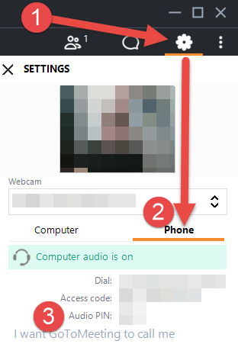
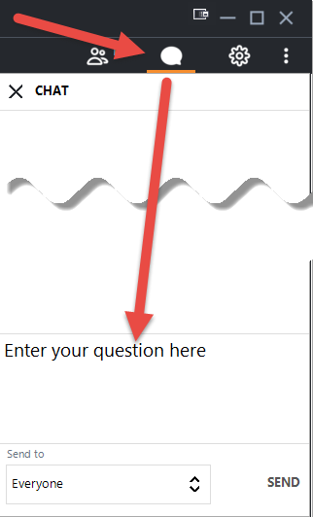
Welcome! The COVID-19 Update Forum will begin shortly.
To participate with audio by phone (mute/unmute, press *6): 1. Select the gear icon on the right control panel
2. Select the ‘Phone’ option
3. Be sure to enter your Audio PIN so we can help answer your questions!
To participate with audio via your PC (mute/unmute using mic icon):
Ensure the right mic/speakers are selected under the ‘Computer’ option.
Please mute yourself when you are not speaking.
You can also ask questions via the Chat feature:
This meeting will be recorded.

Slide 2
COVID-19

Slide 3
COVID Funding Updates
SBA EIDL & EIDL Advance Updates
EIDL Advance (Grant)/Loan Update:
SBA has announced that all available funds for the EIDL Advance grant program have been allocated. SBA is not able to issue EIDL Advances based on the exhaustion of the once program funding has been obligated and is no longer available.
EIDL loan applications will still be processed even though the Advance is no longer available.
HHS
Portal for COVID-19 Testing & Treatment for Uninsured Still Open!
Enhanced Relief Portal for Medicaid Based Relief Open until July 20, 2020!
Only available if Provider received no funding in $50B General Allocation.
Suggest to your independent peds to log in ASAP to start process of validating TIN as eligible.
Can take up to 48 hours to validate!
Enhanced Relief Portal now Open to Dentists until July 24, 2020!
(Might open door for more Non-Medicare/Non-Medicaid providers)

Slide 4
COVID Funding Updates
HHS Announcement of Additional $4B Added to Existing Distributions
$3 BILLION ALLOCATED for ADDITIONAL SAFETY NET HOSPITALS
Newly qualified PPS hospitals will have:
A Medicare Disproportionate Payment Percentage (DPP) of 20.2 percent or greater;
Average Uncompensated Care per bed of $25,000 or more. For example, a hospital with 100 beds would need to provide $2,500,000 in Uncompensated Care in a year to meet this requirement;
Profitability of 3 percent or less based on an average of two consecutive years in the last 5-year period (based on CMS Cost Reports).
Recipients will receive a minimum distribution of $5 million and a maximum distribution of $50 million.
In Georgia, an additional 9 hospitals have been identified for this round of funding.

Slide 5
COVID Funding Updates
$1 BILLION ALLOCATED for ADDITIONAL RURAL HOSPITALS/RHCs
HHS is expanding the existing payment formula to include certain special rural Medicare designation hospitals in urban areas as well as others who provide care in smaller non-rural communities.
Payment Methodology:
Rural Acute Care Hospitals and Critical Access Hospitals
Graduated Base Payment* + 1.97% of the Hospital's Operating Expenses *Base payments ranged between $1 million to $3 million.
Rural Health Clinics (RHC)
Payment Allocation per Independent RHC = $100,000 per clinic site + 3.6% of the RHC's Operating Expenses
In Georgia, an additional 18 hospitals/RHCs have been identified for this round of funding.
Remaining $20.6B Still to be Allocated for Provider Relief

Slide 6
Tax Implications for HHS Relief Funding
The IRS issued guidance on 7/10/2020 that HHS grants to for-profit healthcare providers; including hospitals and independent physician practices are taxable income.
Impact on 7/15/2020 quarterly tax filings:
Potential penalties for mis-reporting HHS relief funds?
Push for Congressional Relief:
Now that the IRS has issued its interpretation, exempting for-profit providers from having to pay taxes on the grants would be considered as new spending.
May be considered as part of 4th Stimulus Package.
Reminder that PPP loan & forgiveness are tax-exempt.

Slide 7
Tax Implications for HHS Relief Funding
Updated HHS FAQs based on IRS Guidance:
Question: May a health care provider that receives a payment from the Provider Relief Fund exclude this payment from gross income as a qualified disaster relief payment under section 139 of the Internal Revenue Code (Code)? (Added 7/10/2020)
Answer: No. A payment to a business, even if the business is a sole proprietorship, does not qualify as a qualified disaster relief payment under section 139. The payment from the Provider Relief Fund is includible in gross income under section 61 of the Code. For more information, visit the Internal Revenue Services’ website.
Question: Is a tax-exempt health care provider subject to tax on a payment it receives from the Provider Relief Fund? (Added 7/10/2020)
Answer: Generally, no. A health care provider that is described in section 501(c) of the Code generally is exempt from federal income taxation under section 501(a). Nonetheless, a payment received by a tax-exempt health care provider from the Provider Relief Fund may be subject to tax under section 511 if the payment reimburses the provider for expenses or lost revenue attributable to an unrelated trade or business as defined in section 513. For more information, visit the Internal Revenue Services’ website.

Slide 8
Medicare Advanced/Accelerated Payment
Clock is Ticking on Repayment/Recoupment
Recoupment will begin 120 days after payment was issued by Palmetto.
Status of Forgiveness Legislation....
Congress in Recess Until 7/20 so no movement until after then.
HR 7292-The COVID 19 Hospital Forgiveness Act
Limits MAPP forgiveness to hospital providers only.
Critical to outreach to American Medical Association/Federal Legislators to ensure forgiveness is expanded to all provider types.

Slide 9
Medicare Advanced/Accelerated Payment
To bypass recoupment reconciliation process, Palmetto advises on the process to repay the advance directly:
https://www.palmettogba.com/palmetto/providers.nsf/DocsR/Providers~JJ%20Part%20B~Browse%20by%20Topic~Emergency%20and%20Disaster%20Instructions~BN7TRE5536?open
Palmetto GBA offers several options to repay Accelerated/Advance Payments. We highly recommend using eServices, through the eCheck function. This option is secure, fast and easy. However, you may still submit a hardcopy form. You will need to access the hardcopy form on the Palmetto GBA website under Forms/Tools, then Finance/Overpayments.
To use eServices, and if you are a provider administrator, you may access the eCheck sub-tab under Financial Tools, entitled “Financial Forms.” If you are a provider user, you must be granted permission to the Financial Tools tab by your provider administrator. The form is dynamic and contains edits to ensure that the information needed to process the payment is entered. In the form, please upload a document stating the payment is related to repaying of an Accelerated/Advance Payment.

Slide 10
PPP Updates
Banks still waiting on guidance from SBA in order to actually start processing forgiveness applications.
No timeline submitted by SBA for processing forgiveness documentation.
Banks likely building portals for data submission similar to loan requests.
Potential legislative development:
Paycheck Protection Program Small Business Forgiveness Act:
Bipartisan bill that would expedite forgiveness for most borrowers.
Allow PPP loans of $150,000 or less to be automatically forgiven upon completion of one-page forgiveness document.
No rush to submit for forgiveness.
But....Don't forget about FTE calculation in addition to spending documentation.
.

Slide 11
Health Insurance Access Concerns
Longer-term implications of the COVID crisis on the health insurance landscape
Shifting payer mix towards uninsured/self-pay as individuals lose employer based coverage.
From the New York Times..."The economic downturn caused by the pandemic has led to the largest decline in health coverage on record: An estimated 5.4 million American workers lost their health insurance between February and May, according to a new study.”
55.1% of health coverage in the United States is employer-sponsored.
180 million Americans received health insurance through their employer; based on COVID crisis, 27 million have already lost this coverage.
Advocacy efforts underway for Congressional action to ensure continued access to health coverage:
Adapting/Subsidizing COBRA?
Access to purchase other coverage options (i.e. Exchange).
Specific advocacy via national organizations.
.

Slide 12
HHS Public Health Emergency Extension
HHS Expected to Renew Public Health Emergency that is set to expire on 7/25/2020.
Extension would last another 90 days from 7/25/2020
By extending the PHE, notable policies that will also be extended are:
Medicare Inpatient 20% Add-On for COVID 19 patients.
Increased federal Medicaid matching rates.
Requirements that insurers cover COVID 19 testing without cost sharing.
Waivers on telehealth restrictions.

Slide 13
FFCRA Considerations
Impact of School Opening Decisions on eFMLA/Emergency Sick Leave
Impact on employees & employers
Under FFCRA, healthcare providers can exempt themselves from providing eFMLA
Key Factors to Consider For Such Exemptions:
Apply it judiciously.
Apply it to all employees that are the same or similarly situated.
Do not discriminate when determining an individual's exemption status.
What triggers EFMLA?
Closure of schools/daycare leaving employees with the need to care for minor children
What triggers Emergency Sick Leave?
Employee COVID diagnosis or COVID diagnosis of family members

Slide 14
Wrap Up & Questions

