Slide 1
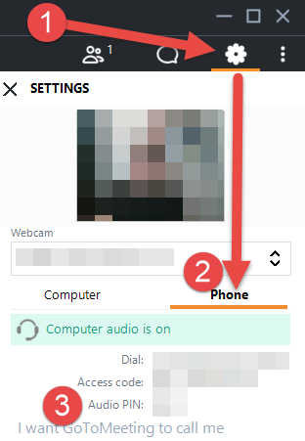
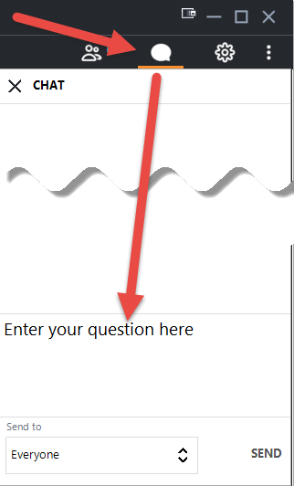
Welcome! The COVID-19 Update Forum will begin shortly.
To participate with audio by phone (mute/unmute, press *6): 1. Select the gear icon on the right control panel
2. Select the ‘Phone’ option
3. Be sure to enter your Audio PIN so we can help answer your questions!
To participate with audio via your PC (mute/unmute using mic icon):
Ensure the right mic/speakers are selected under the ‘Computer’ option.
Please mute yourself when you are not speaking.
You can also ask questions via the Chat feature:
This meeting will be recorded.

Slide 2
DOI Forum Update/ BCBSGA

Slide 3
BCBSGA
Term of BCBS Physician PPO/HMO Agreements
Have you received a BCBSGA new agreement?
Email Keyword Search: Sonya Hollis, One Span, One Span Partner
Access new rates in Availity
Effective date of termination/effective date of new agreement- 11/15/20
Pathways Agreement Terminations
Department of Insurance Notifications

Slide 4
DOI Forum Follow Up
Nonpatient Lab limitations- UHC/Cigna/Aetna
Systemic Underpayments- Several carriers
Unilateral Fee Schedule Adjustments
Closed Provider Panels
Network Adequacy- Some push for next state legislative session.
Clear need to increase number of complaints/outreach to DOI.

Slide 5
COVID-19 Updates

Slide 6
HHS Provider Relief Fund
New Nursing Home Distributions
$2.5B Distributed in Late August- Based on number of beds (similar to first NH round).
Terms & Conditions: Funds can be used for COVID expenses related to infection control but cannot offset lost revenue.
$2B Coming in the Fall with additional parameters.
COVID 19 Uninsured Portal Still Open
General Distribution Portal
For Hospitals/Practices who haven’t submitted previously.
Remains Open through 9/13/2020.
Enhanced Distribution Portal for Medicaid & Dental Providers
Remains Open through 9/13/2020.

Slide 7
HHS Provider Relief Reporting- What we know?
All recipients receiving over $10,000 in PRF will be required to report.
Reporting guidance was originally scheduled to be released on August 17 but is still pending.
Updated Reporting FAQ for Allowable COVID Expenses:
Supplies
Equipment
Workforce training
Reporting COVID-19 test results to federal, state, or local governments.
Building or constructing temporary structures for COVID-19 patient care or non-COVID-19 patients in a separate area.
Acquiring additional resources, including facilities, supplies, or staffing to expand or preserve care delivery.
Developing and staffing emergency operation centers.
Still missing parameters around lost revenue estimates, etc.

Slide 8
HHS Provider Relief Reporting
Reporting Timelines
Reporting Portal: scheduled to be available on 10/1/2020.
Initial Report: Due on February 15, 2021 for all Spending through 12/31/2020.
Second & Final Report: Due in July 2021 for any funds expended on 1/1/2021 or later.

Slide 9
Hospital Cost Report Updates
Question: Should HHS Provider Relief Fund (PRF) payments offset expenses on the Medicare cost report?
Answer: No, providers should not adjust the expenses on the Medicare cost report based on PRF payments received. However, providers must adhere to HRSA’s guidance regarding appropriate uses of PRF payments, in order to ensure that the money is used for permissible purposes (namely, to prevent, prepare for, or respond to coronavirus, and for health care related expenses or lost revenues that are attributable to coronavirus) and that the uses of the PRF payments do not violate the prohibition on using PRF money to reimburse expenses or losses that have been reimbursed from other sources or that other sources are obligated to reimburse.

Slide 10
Hospital Cost Report Updates
Question: Should SBA loan forgiveness amounts offset expenses on the Medicare cost report?
Answer: No. Do not offset SBA Loan Forgiveness amounts against expenses unless those amounts are attributable to specific claims such as payments for the uninsured. The Paycheck Protection Program loan administered by the SBA is a loan designed to provide a direct incentive for small businesses to keep their workers on the payroll. The terms and conditions of the SBA loan forgiveness, overseen by the SBA, include employee retention criteria, and the funds must be used for eligible expenses.

Slide 11
Medicare Advanced/Accelerated Payment
Recoupments/Repayments Put on hold 8/7/20 by CMS. Still on hold currently.
Status of Forgiveness Legislation....
Congress in Recess Until 10/20 so no movement until after then.
HR 7292-The COVID 19 Hospital Forgiveness Act
Limits MAPP forgiveness to hospital providers only.
AMA Advocacy Efforts continue to include Physicians.
Likely no movement on Round 4 stimulus until after the general election.
(So, hopefully, recoupments will remain on hold until then.)

Slide 12
PPP Updates
Banks starting to issue guidance on accepting forgiveness applications.
No timeline submitted by SBA for processing forgiveness documentation.
Banks building portals for data submission similar to loan requests.
Example: Truist portal apparently available for first phase of forgiveness applicants.
Potential legislative development:
Paycheck Protection Program Small Business Forgiveness Act:
Bipartisan bill that would expedite forgiveness for most borrowers.
Allow PPP loans of $150,000 or less to be automatically forgiven upon completion of one-page forgiveness document.
No rush to submit for forgiveness.
But....Don't forget about FTE calculation in addition to spending documentation.
.

Slide 13
Congressional Stimulus- Round 4
New $500B Stimulus Bill Introduced on September 8, 2020
Senator McConnell expected to push for a vote this week in Senate.
Key Priorities
Creates 2nd Round PPP loans-
300 or fewer staff employers who show >35% loss in revenue from same quarter last year.
USPS Loan Forgiveness- $10B loan in CARES Act.
Vaccine Development
Slimmed down unemployment benefits
Farming relief
School choice tax credits/Education Stabilization Fund- “To help get students back to school”.
No new provider relief funds in Senate package.
House declares bill a “non-starter” vs. $2.2T bill (Heroes Act) previously based.
Agreement prior to general election appears unlikely.

Slide 14
Wrap Up & Questions

