Slide 1
SHP Lunch ‘n’ Learn Fall Series: Provider Enrollment Best Practices
Raquel Grizzard and Melissa Gibbs
Strategic Healthcare Partners

Slide 2
SHP Lunch ‘n’ Learn Fall Series
November 18 – COVID Latest & Greatest
Late Nov / Early Dec – QPP 2021 Final Rule
Late Nov/ Early Dec – Physician Fee Schedule Final Rule
December 18 – COVID Latest & Greatest
Register today at shpllc.com/webinars
Notes:
This fall, SHP will be conducting regular webinars to dive deeper into content that is relevant and timely to you and your organization. If you haven’t looked at the full line-up of webinars, head over to our website at shpllc.com/webinars.

Slide 3
Speakers
Raquel Grizzard
Provider Enrollment Initiatives Manager
Joined SHP March 2014
Melissa Gibbs
Provider Enrollment Department Manager
Joined SHP June 2017
Nearly 10 combined years experience with provider enrollment: Initial credentialing and recredentialing
Facility Enrollment
Provider Enrollment
New Practice Start Up
Joint Ventures
Full PE outsourcing
Help Desk/Training programs for employees & practices to keep enrollment “in house”

Slide 4
Topics
What is Provider Enrollment?
Provider Enrollment Process
Provider Enrollment Best Practices
Q&A

Slide 5
What is Provider Enrollment?
Notes:
Before we get into the weeds, let’s jump through a quick refresher to help keep everything straight.

Slide 6
Provider Enrollment is…
The process by which a medical professional has their credentials properly vetted and accounted for, to meet national guidelines for network participation.
Required for most medical professionals (MD/DO, NP, PA, LPC, MFT, CRNA, DMD).
Often goes hand in hand with contracting.
Being enrolled is how you get paid.
Non-enrolled providers are often not paid any out of network benefits and the cost is passed on to your patient.
Notes:
Provider Enrollment is the process by which a medical professional has their credentials properly vetted and accounted for, to meet national guidelines for network (health plan) participation. (Ensuring provider has had adequate training and will provide safe care to patients.)
It is required for most medical professionals (MD/DO, NP, PA, LPC, MFT, CRNA, DMD).
Provider Enrollment often goes hand in hand with contracting.
Provider enrollment is important be cause being enrolled is how you get paid.
Non-enrolled providers are often not paid any out of network benefits and the cost is passed on to your patient.

Slide 7
Provider Enrollment Process
Notes:
You may have heard this term used before but may not be familiar with what a proposed rule is. Whenever CMS or any government agency for that matter, wants to change the regulations for a law, they must first release a proposed rule. This gives time for the public to read the rule and make comments on the rule, so the agency can adjust and tweak the rule changes to best fit the public need. Historically, CMS has made changes between the proposed and final rule based off public input. I would expect this rule to be no different. As soon as the final rule is released, we will have a webinar for you all.

Slide 8
Provider Enrollment Process
Timeframe of enrollment process: 90-180 days
Step One: Data Collection – Provider/Facility/Practice, etc.
Step Two: Application Submission – this may also include obtaining contracts.
Step Three: Follow Up, Follow Up, Follow Up
Notes:
Before we get into what the best practices in Provider Enrollment are, we wanted to do a fly over of the provider enrollment process. If anyone has ever gone through this process, you know its never as simple as 1,2,3, but this is a general overview…
Start to finish, it takes anywhere from 90-180 days from submission to get providers credentialed and fully loaded and enrolled with the payers. So as we'll talk about a little later, you want to start enrollment on a provider as soon as you can so that the provider can begin seeing patients and start getting paid as quickly as possible.
Step 1: Data Collection
-Determine what type of enrollment is needed, whether it’s a new provider, a new location for an existing practice, or a brand new practice and TIN. This will help you to know what documents and data you will need to collect.
Step 2: Application Submission
-Determine which payers your provider wants to participate in, make sure you have contracts in place and start submitting applications.
Step 3: Follow Up
-Follow up on submitted applications until you receive approval from payers.
-In my experience, this is usually the most difficult step in the process.

Slide 9
Roadblocks Are Inevitable
Different payer, different apps, different requirements
Payer requirements change and checklists fail
Difficulty communicating with payers
Lost applications
Notes:
As I mentioned before it is never as easy as collect data, submit apps, get approval…because the nature of the process, there will always be roadblocks and obstacles…
Each payer has a different process, different apps, and different requirements, unfortunately there is not a lot of standardization. Payers will ask for generally the same information across the board, but the applications/processes that they use are never the same.
Payer requirements change without warning or notice and then the data we have collected previously is not sufficient or the applications submitted are no longer valid.
Communication with payers is often times difficult. Some payers will sporadically communicate and others will not at all. There also tends to be a lot of payer rep turn over which does not help our communication efforts.
Payers lose applications, systems glitch, or they get stuck in application purgatory and no one can seem to find them.
As we have all experienced these and many other obstacles, the rest of our presentation will be about how you can avoid and mitigate some of these road blocks…

Slide 10
Provider Enrollment Best Practices

Slide 11
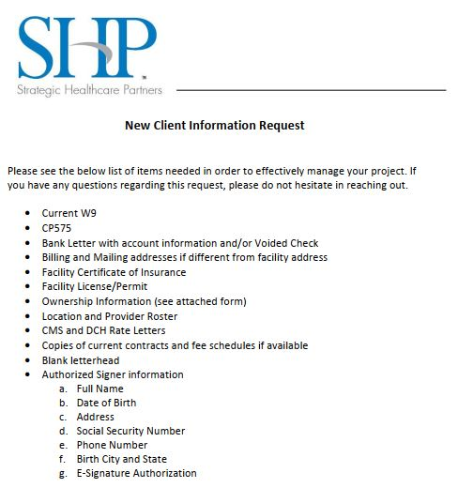
PE Best Practices: Document Collection
Start enrollment process ASAP
What is at stake if you wait?
Checklists
New Providers, TINs, Facilities, Locations
Information required may differ based
on enrollment needs
Review Checklists Bi-Annually:
CMEs and licenses/certificates expire
Providers move
Payer requirements change
Notes:
Start Enrollment Process ASAP
What is at stake if you wait?
Loss of start up revenue
Longer wait to establish referral streams
Checklists
New Providers, TINs, Facilities, Locations
Depending on the type of enrollment needing to be done, the checklists will be different. We have checklists for new TINs, New Locations and New Providers.
Information required may differ based on enrollment needs
If a provider is being credentialed by Med Staff, there is much more detailed information required than for payer credentialing
Review Checklists Bi-Annually:
CMEs and licenses/certificates expire – Audit required of your provider’s files
Providers move
Payer/Med Staff requirements change

Slide 12
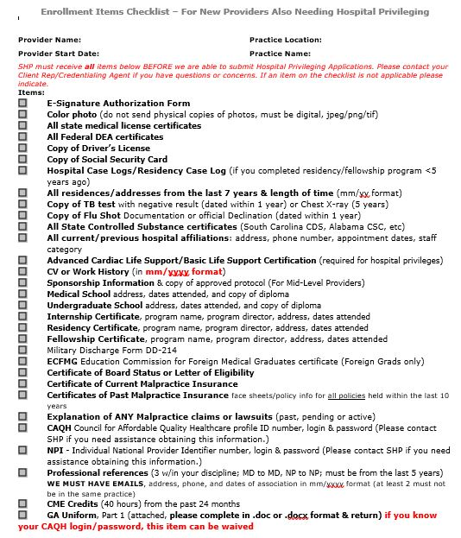
PE Best Practices: Document Collection

Slide 13
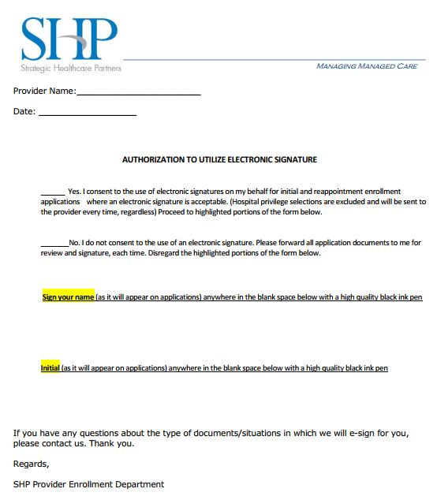
PE Best Practices: Document Collection
E-Signature Authorizations
Notary on Site
References
Most apps require 2-3, ask for 5
from provider to ensure we have responses
Utilize the GA Uniform App and/or CAQH
Notes:
E-Signature Authorizations (see example) –
Allows us to use an E-Signature for most applications
Speeds up the process and don’t have to hunt down the provider for wet signatures.
There are exceptions to what we can sign – Hospital Privileges
Notary on Site – Speeds up process
References
Most apps require 2-3, ask for 5 from provider to ensure we have responses
Utilize the GA Uniform App and/or CAQH
These apps are standard and used across the state by payers and hospitals, these apps are very detailed and require just about all information that is needed for credentialing. You will still need to get copies of identifiers, etc.

Slide 14
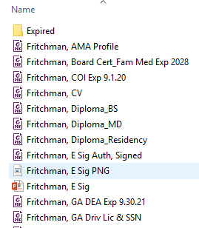
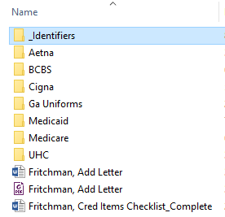
PE Best Practices: Document Collection
File Organization – Find a system and stick with it!
Example:
Notes:
File Organization – Find a system and stick with it!
Example: This is the file structure we use, we have a Client File with a PE folder inside. Inside of that folder we have individual provider folders. Inside the provider folders we have Identifiers (where we house any identifying information, License, DEA, CV, Board Certs, etc.) and folders for each of the payers. The more organized you are on the front end, the easier it is to find things you need later when payers are questioning whether apps have been submitted, etc.

Slide 15
PE Best Practices: Application Submission
Use online portals when available
PECOS/Medicare
GAMMIS/Medicaid
CAQH
Commercial Payer Portals
Tracking Submission/Application Status
Maintain tracking numbers of all online submissions
Save all online applications and submission confirmations
Save copies of ALL applications submitted
Print secure emails, because they EXPIRE
Get names/ref #’s when calling to confirm receipt or follow up
Notes:
Application Submission!!
It is best practice to use online portals when they are available
PECOS/Medicare – faster processing time than mail-in, ability to track in the portal
GAMMIS/Medicaid – allows for email/online updates, rather than mail, ability to track in portal
CAQH – This is an online provider portal that houses a lot of the provider's demographic and identifying information. Most commercial health plans are moving to using this model, cuts down on the paperwork/apps you have to use, but you have to reattest this every quarter.
Commercial Payer Portals – BCBS (availity) and UHC (optum link) have recently moved to online portals for enrollment submission and tracking
Tracking Submission/Application Status
Maintain tracking numbers of all online submissions
Save all online applications and submission confirmations
Save copies of ALL applications submitted online or via paper
Print secure emails, because they EXPIRE
Get names/ref #’s when calling to confirm receipt or follow up

Slide 16
PE Best Practices: Follow Up
Tracking Submission/Application Status through Follow Up
Tracking Grid – Pick a system and stick with it (Excel/spreadsheet)
Follow up with payers frequently
First Follow Up: 10 days to two weeks after submission to verify receipt of application
Subsequent Follow Up: Every two weeks until approval status has been received
Document follow up attempts – put the # of attempt on correspondence
Use tracking numbers in online portals
Ask for and save copies of approvals/denials (try to keep a paper trail)
Build Relationships with the Payers
Notes:
Tracking Submission/Application Status through Follow Up
Tracking Grid – Pick a system and stick with it. (Excel/spreadsheet)
Excel Spreadsheet
Word Document
Other Software like Credential My Doc and such.
Follow up with payers frequently
First Follow Up: You will want to make your first follow up about two weeks after submission to verify receipt of said application. You can either reach out to the rep, or payer general inbox by email, or call to ensure that they have received your application.
Subsequent Follow Up: We suggest following up every two weeks after confirmation of receipt until you have received approval status.
If you're not getting anywhere with email, try calling to get an update.
I like to set reminders on my calendar/email to remind me when it is time to follow up with a payer.
Document follow up attempts – This is the most important! Document document document!
Keep notes of when/how/and with whom follow up was done.
Document submission dates, follow up dates, dates that payers requested additional information, tracking numbers etc.
Put the # of attempt on correspondence with payer reps
Use tracking numbers in online portals
Ask for and save copies of approvals/denials
So important to keep a paper trail and be able to provide proof of submission/follow up attempts if payers lose applications.
Build Relationships with the Payers
They are more likely to respond faster to a familiar name!
Network with payers via Linked In
Be friendly in correspondence
Call payer reps to build relationships

Slide 17
Got Questions?
Send us your Provider Enrollment questions:
pe@shpllc.com
Complete our webinar survey!

Slide 18
Who is SHP?
Performance Analytics
Provider Enrollment
We offer real-time data dashboard backed by a team of analysts to deliver actionable information for better financial, operational, and population health management.
Maintaining provider enrollment is an important and often time consuming process. We can get you enrolled and take the burden off your practice with ongoing enrollment maintenance.
Managed Care Contracting
IPA & CIN Management
Our contracting team has relationships with insurance companies and can help you negotiate the best fee schedules.
We manage four IPAs across the state of Georgia and provide consultation and management services for CINs nationwide.
Notes:
SHP is based in Savannah, GA. We are the “support team” for your practice, hospital, IPA or CIN. We can help your organization focus on what is most important: patient care. These are just some of the services that we offer, give us a call or visit our website to see if these services are right for your organization.

Slide 19
SHP Lunch ‘n’ Learn Fall Series
November 18 – COVID Latest & Greatest
Late Nov / Early Dec – QPP 2021 Final Rule
Late Nov/ Early Dec – Physician Fee Schedule Final Rule
December 18 – COVID Latest & Greatest
Register today at shpllc.com/webinars
Notes:
This fall, SHP will be conducting regular webinars to dive deeper into content that is relevant and timely to you and your organization. If you haven’t looked at the full line-up of webinars, head over to our website at shpllc.com/webinars.

