Slide 1
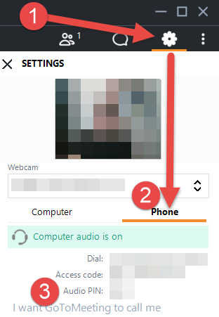
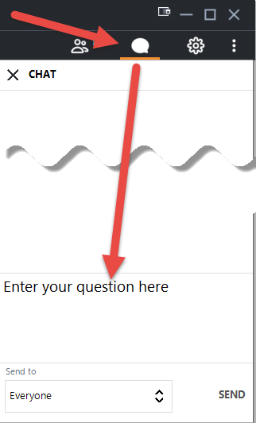
Welcome! The HHS Provider Relief Reporting Webinar will begin shortly.
To participate with audio by phone (mute/unmute, press *6): 1. Select the gear icon on the right control panel
2. Select the ‘Phone’ option
3. Be sure to enter your Audio PIN so we can help answer your questions!
To participate with audio via your PC (mute/unmute using mic icon):
Ensure the right mic/speakers are selected under the ‘Computer’ option.
Please mute yourself when you are not speaking.
You can also ask questions via the Chat feature:
This meeting will be recorded.

Slide 2
HHS Provider Relief Fund Reporting

Slide 3
HHS Reporting
Who is Required to Report?
Recipients of Payments more than $10,000 in the aggregate under the following distributions:
General Distributions:
Phase #1-Medicare
Phase #2-Net Patient Revenue
Phase #3-Equality for Net Patient Revenue across more provider types plus additional allocation (undefined at this point) based on lost revenue
Targeted Distributions:
Safety Net Hospital
Rural Hospital & Rural Health Clinic
COVID High Impact Rounds 1 & 2
Medicaid Distribution
Reminder- Original terms and conditions: Recipients agree that funds will only be used to prevent, prepare for, and respond to Covid and shall reimburse recipient only for health care-related expenses or lost revenues attributable to coronavirus.

Slide 4
HHS Reporting Exclusions
Are any HHS/HRSA Funds Excluded from this Reporting?
Yes! These final reporting requirements do not apply to:
Nursing Home Infection Control distribution recipients
Rural Health Clinic Testing distribution recipients
Health Resources and Services Administration (HRSA) Uninsured Program reimbursement recipients

Slide 5
HHS Reporting Key Dates
January 15, 2021: HHS/HRSA reporting system opens for providers
February 15, 2021: first reporting deadline for all providers on use of funds expended/lost revenues through 12/31/20.
July 31, 2021: final reporting deadline for providers who did not fully expend PRF funds prior to December 31, 2020, through 6/30/21 activity.
Will extensions be available for reporting? Per HHS FAQs, YES!!
Non-Federal Agencies: See OMB website for details at https://www.whitehouse.gov/omb/information-for-agencies/memoranda/
Commercial Agencies: Email HRSA's Division of Financial Integrity at SARFollowup@hrsa.gov

Slide 6
HHS Reporting: The Basic Formula (Originally)
Applicable Provider Relief Funds Received, less:
Expenses Attributable to Coronavirus, :
General & Administrative Expenses
Healthcare Expenses Related to Coronavirus
Year over year lost revenues
KEY REMINDER…..Based on the HHS Terms & Conditions, all PRF payments cannot be used to reimburse expenses or losses that have been reimbursed from other sources or that other sources are obligated to reimburse.

Slide 7
Attributable Expenses
Expenses Attributable to Coronavirus
General and administrative (G&A) expenses
Healthcare-related expenses
(Expenses attributable to the virus NOT reimbursed by another source; insurance/patients/other governmental agencies).
Did you receive over $500,000 in PRF funding?
If yes; HHS will require more detailed data on:
Mortgage/rent
Personnel
Utilities
Supplies
Equipment
and other high-level expense categories

Slide 8
Additional Clarification on Expenses
Healthcare Related Expenses Attributable to Coronavirus
Expenses attributable to coronavirus may be incurred through:
Direct patient care overhead activities related to treatment of confirmed or suspected cases of coronavirus.
Preparing for possible or actual coronavirus cases.
Maintaining or expanding healthcare delivery capacity which includes operating and maintaining facilities, etc.; (including lease/purchase of new structures/modifications of structures to accommodate revised treatment practices).
Based on HHS parameters for reporting, it is clear that HHS believes that expenses attributable to COVID will far outweigh lost revenue usage.

Slide 9
Salary & Employee Compensation
Salary & Employee Compensation: through their FAQs, HHS has greatly expanded the employee/owner compensation that can be attributable to COVID under the General & Administrative section.
"Direct employee (full and part-time), contract labor and temporary worker expenses are eligible expenses provided that they are not reimbursed from other services, or only the incremental unreimbursed amounts are claimed."
Considerations:
Any compensation forgiven under a PPP Loan or a FEMA type grant will not be eligible for inclusion in this; BUT the PPP only covers a brief portion of the COVID crisis as currently defined by HHS (runs from March 2020-June 2021).
The timeline appears to be the 16 month period above vs. the period of the public health emergency.
Limits Executive salary to $197,300 which can be claimed on any given staff member.
“Reimbursement from other sources” appears to be PPP/FEMA/any other grant offset; Not reimbursement of services billed/collected by a provider.
Are fringe benefits for both patient care staff and General & Administrative Staff considered a PRF eligible expense?
Yes, as long as they are not reimbursed under other sources.

Slide 10
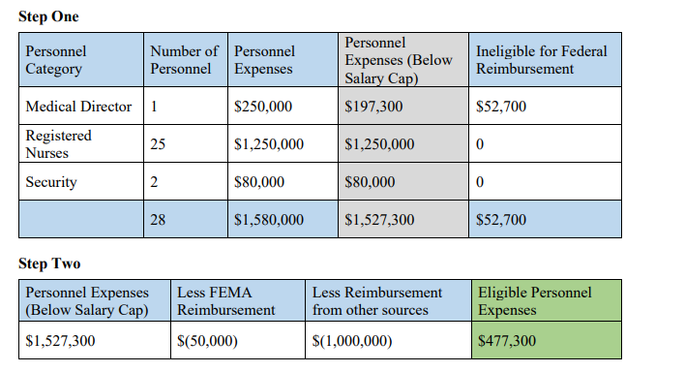
Salary & Employee Compensation Example
This appears to include all salary and fringes for all staff (or at least all clinical staff) regardless of Covid patient treatment. If that’s true, this category will ultimately be the largest amount of eligible offset to PRF.

Slide 11
Calculating Healthcare Expenses due to COVID
When reporting my organization's healthcare expenses attributable to coronavirus, how do I calculate the "expenses attributable to coronavirus not reimbursed by other services"??
May include supplies; equipment, IT, facilities, employees, etc.
Providers can identify their expenses and then offset any amounts received through other services (I.e. health plan reimbursement; patient payment; etc)
The PRF permits reimbursement of marginal increased expenses related to COVID.
I.E.-Assume a $5 increase in expense or cost to provide an office visit when comparing pre-pandemic cost, regardless of reimbursement source (Medicaid, Medicare, etc):
Pre-Pandemic Average Expense or Cost: $80 per visit
Post-Pandemic Average Expense or Cost: $85 per visit
This appears to be an example amount, but the FAQs are unclear as to whether a blanket amount will be allowed OR whether this is a calculated amount. If calculated, missing guidance on methodology.

Slide 12
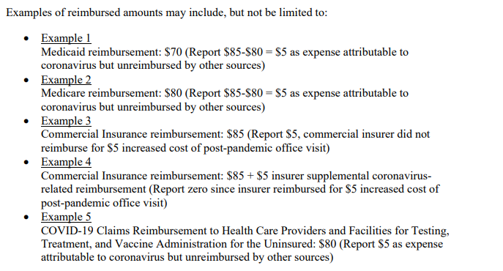
Calculating Healthcare Expenses Example:

Slide 13
Other Healthcare Expense Process
When reporting my organization’s other non-salary/benefits healthcare related expenses attributable to coronavirus, how do I calculate the “expenses attributable to coronavirus not reimbursed by other sources”?
Providers first calculate their expenses for supplies, equipment, IT, facilities, and other healthcare related costs/expenses for calendar years 2019 and 2020, calculate the change in year over year expenses and identify the portion that is attributable to coronavirus.
Provider will then apply reasonable assumptions to determine the amount of their “Total Revenue /Net Charges from Patient Care Related Sources” and “Other Assistance Received” that applies to each type of healthcare expense attributable to coronavirus. For example:
PPE Supplies in 2019 = $1,000
PPE supplies in 2020 = $4,000
$4,000 – $1,000 = $3,000 in expenses over and above normal operations attributable to coronavirus
Of that $3,000, approximately $2,500 was attributable to coronavirus, and of that $2,500 approximately $1,000 was reimbursed, leaving a balance of $1,500 in unreimbursed healthcare related expenses attributable to coronavirus.

Slide 14
Unanswered Questions- Expenses
Salaries/Benefits appears to allow either all salaries (or at least all direct clinical salaries) less PPP/FEMA/HRSA reimbursement. Need to clarify whether other reimbursement is offset similar to other expenses.
Also for salaries/benefits- There is a reference to eligible expenses being “not reimbursed from other services, or only the incremental unreimbursed amounts”, yet the concept is not reflected in the example?
How will HHS define incremental costs as noted in that section?
For “Other” expenses- How do we report any eligible expenses at all if a profit is reported and, in theory, the expenses are fully offset?
How do we translate the result of “Other” expenses to an incremental “per visit” add on? Or, is that a flat amount to be automatically added by everyone?

Slide 15
Equipment Purchase/Capital Parameters for PRF Reporting
Can providers include the entire cost of capital facilities projects as eligible expenses, or will eligible expenses be limited to the depreciation expense for the period?
Expenses for capital facilities may be fully expensed only in cases where the purchase was directly related to preventing, preparing for and responding to the coronavirus.
Examples of these types of facilities projects include:
Upgrading a heating, ventilation, and air conditioning (HVAC) system to support negative pressure units
Retrofitting a COVID-19 unit
Enhancing or reconfiguring ICU capabilities
Leasing or purchasing a temporary structure to screen and/or treat patients
Leasing a permanent facility to increase hospital or nursing home capacity

Slide 16
Equipment Purchase/Capital Parameters for PRF Reporting
Will the Provider Relief Fund limit qualifying expenses for capital equipment purchases to 1.5 years of depreciation, or can providers fully expense capital equipment purchases?
Expenses for capital equipment and inventory may be fully expensed only in cases where the purchase was directly related to prevent, prepare for and respond to the coronavirus.
Examples of these types of equipment and inventory expenses include:
Ventilators, computerized tomography scanners, and other intensive care unit- (ICU) related equipment put into immediate use or held in inventory
Masks, face shields, gloves, gowns
Biohazard suits
General personal protective equipment
Disinfectant supplies

Slide 17
Equipment Purchase/Capital Parameters for PRF Reporting
For all other capital purchases which meet the definition of “maintaining access to care” but not directly attributable, how are eligible expenses calculated?
Providers who use accrual or cash basis accounting may report the relevant depreciation amount based on the equipment useful life, purchase price and depreciation methodology otherwise applied. (I.e. Can report the depreciation that would have been booked normally that occurs from March 2020-June 2021).
Providers may fully report an expense for items purchased with a useful life of 12 months or less if in accordance with their existing accounting policies.
For additional information on capital depreciation, please refer to the other Frequently Asked Questions related to capital equipment and capital facility projects.

Slide 18
Hierarchy of Funding Offsets for Reporting Purposes
Funds from the Federal Emergency Management Administration (FEMA) are generally intended to be the last source of reimbursement, however, the Post-Payment Notice of Reporting Requirements indicates that FEMA funds would be applied prior to the Provider Relief Fund distributions. In which order should governmental funding sources be applied and reported?
As it relates to expenses, providers identify their health care-related expenses, and then apply any amounts received through:
Other sources (e.g., direct patient billing, commercial insurance, Medicare/Medicaid, reimbursement from the Provider Relief Fund COVID-19 Claims Reimbursement to Health Care Providers and Facilities for Testing, Treatment, and Vaccine Administration for the Uninsured, or funds received from FEMA or SBA/Department of Treasury’s Paycheck Protection Program) that offset the health care-related expenses.
PRF payments may be applied to the remaining expenses or cost, after netting the other funds received or anticipated to offset those expenses.

Slide 19
Lost Revenue Calculations
When reporting use of funds, how will my organization’s “lost revenues attributable to coronavirus” be calculated?
Lost revenues attributable to coronavirus are calculated based upon a calendar year comparison of 2019 to 2020 actual revenue/net charges from patient care (prior to netting with expenses). HHS has clarified provider will no longer be required to net healthcare related expenses against patient care lost revenue.
So, the process of identifying direct healthcare expenses and netting down revenues to offset is gone.

Slide 20
Lost Revenue Calculations
What is the maximum allotment of my organization’s Provider Relief Fund amount that can be allocated to lost revenue in 2020?
Unreimbursed expenses attributable to coronavirus are considered first in the overall use of funds calculation.
Provider Relief Fund payment amounts not fully expended on unreimbursed healthcare related expenses attributable to coronavirus are then applied to lost revenues for 2020, which is capped at the change in 2019 to 2020 actual revenue from patient care (i.e., patient care revenue in 2019 less patient care revenue in 2020).
Recipients that reported increased revenue from patient care in 2020 as compared to 2019, are eligible to use Provider Relief Fund payments toward expenses attributable to coronavirus not reimbursed by other sources, however, they would not be considered to have lost revenues attributable to coronavirus for the initial reporting period.

Slide 21
Lost Revenue Calculations
Can I use 2020 budgeted revenues as a basis for reporting lost revenues?
No. When reporting use of Provider Relief Fund money toward lost revenues attributable to coronavirus, Reporting Entities must report actual patient care revenues and expenses for 2019 and 2020, to allow for a year-over-year calculation of change in revenue.
Will the same lost revenue comparison apply to January-June 2021 reporting?
Yes. In cases where funds are not fully expended by December 31, 2020, the Reporting Entity must report actuals from January 1-June 30, 2021 to be compared against the same six-month period in 2019 (actual vs. actual/not budget).

Slide 22
Lost Revenue Calculating Total Revenue/Net Charges
What is considered when calculating “Total Revenue/Net Charges?”
Revenue from Patient Care Payer Mix (2019 and 2020, and for some recipients, 2021 where applicable)
Medicare Part A+B: The actual revenues/net charges received from Medicare Part A+B for patient care for the calendar year.
Medicare Part C: The actual revenues/net charges received from Medicare Part C for patient care for the calendar year.
Medicaid: The actual revenues/net charges received from Medicaid/Children’s Health Insurance Program (CHIP) for patient care for the calendar year.
Commercial Insurance: The actual revenues/net charges received from commercial payers for patient care for the calendar year.
Self-Pay (No Insurance): The actual revenues/net charges received from self-pay patients, including the uninsured or individuals without insurance who bear the burden of paying for healthcare themselves, for the calendar year.
Other: The actual gross revenues/net charges from other sources received for patient care services and not included in the list above for the calendar year.
Note: All sources of patient care revenue should be reported net of uncollectible patient service revenue recognized as bad debts.

Slide 23
Unanswered Questions- Lost Revenues
In the instance where new providers, new services, etc. are added, the methodology appears to give no credit for upward trend interrupted by Covid in a manner that does not ultimately reduce revenue. Will they allow adjustments for change in providers/locations/services?
Similarly, the lost revenue calculation is at the entity/total net revenue as an organization level. There seems to be no allowance for specific services negatively impacted by Covid, yet were part of an organization that, overall maintained total revenue levels vs. 2019. Will there be any allowance for specific services impacted?

Slide 24
Reporting Expenses & Lost Revenue
HHS will require full reporting on both expenses and lost revenue for the full pandemic time period; regardless of whether PRF allocation was met in a shorter timeframe or through only one of the categories.
If all funds are expended through the G&A and healthcare related expenses, are recipients still required to submit lost revenue information?
Yes, all providers above the $10,000 threshold are required to report both revenues and expenses for the calendar year.
If an entity incurred enough lost revenue in April and May 2020 to justify its use of the Provider Relief Fund payments received, can it only report those two months?
The Reporting Entity must report revenue and expense for the full calendar years 2019 and 2020. If funds were not expended in full by December 31, 2020 then a second and final report will be required on use of funds for the period January 1, 2021 - June 30, 2021 which is due no later than July 31, 2021.

Slide 25
Provider Relief Fund- Impact on Cost Report Hospitals Only
How does cost reimbursement relate to my Provider Relief Fund payment?
PRF Recipient must follow CMS instructions for completion of cost reports. Under cost reimbursement, the payer agrees to reimburse the provider for the costs incurred in providing services to the insured population. In these instances, if the full cost was reimbursed based upon this method, there is nothing eligible to report as an expense attributable to coronavirus because the expense was fully reimbursed by another source.
In cases where a ceiling is applied to the cost reimbursement and the reimbursed amount does not fully cover the actual cost due to unanticipated increases in providing care attributable to coronavirus, those incremental costs that were not reimbursed are eligible for reimbursement under the Provider Relief Fund.

Slide 26
Supporting Documentation & Records Retention
What documentation is required for reporting?
No external documentation is required at the time information is submitted via the reporting portal.
Supporting worksheets (for providers who received $500,000 or above in Provider Relief Fund payments) will be included to assist providers within the reporting tool.
What are the documentation retention requirements for the Provider Relief Fund?
Providers need to retain original documentation for three years after the date of submission of the final expenditure report, in accordance with 2 CFR 200.333.

Slide 27
Single-Audit Requirements
For recipients of $750,000 or more in PRF payments, a Single Audit must be submitted. In their FAQs, additional clarification has been provided:
Non-Federal Entities (states, local governments, Indian tribes, schools and nonprofit organizations): Single audit required under 45 CFR Part 75, Subpart F.
Reports submitted to the Federal Audit Clearinghouse electronically at https://harvester.census.gov/facides/Account/Login.aspx
Commercial Entities:
Have two options under 45 CFR 75.216(d) and 75.501(d):
Financial related audit of the award or awards conducted in accordance with Government Auditing Standards
Audit in conformance with the requirements of 45 CFR Part 75, Subpart F
Reports submitted directly to the US Department of Health and Human Services, Audit Resolution Division at auditresolution@hhs.gov

Slide 28
Quick PPP Update- Tax Implications
On November 18, 2020, the Internal Revenue Service (IRS) issued Revenue Ruling 2020-27 and Revenue Procedure 2020-51, which, respectively, provided additional guidance regarding the IRS position on the non-deductibility of expenses funded with Paycheck Protection Program (PPP) loan proceeds and a “safe harbor” for taxpayers wishing to deduct those expenses after either being denied PPP loan forgiveness or ultimately deciding not to file for forgiveness.
The guidance makes clear that taxpayers that received a PPP loan in a taxable year, and paid or incurred otherwise deductible expenses in that year, may not deduct those expenses if, at the end of such year, the taxpayer reasonably expects to receive forgiveness of the PPP loan.
The expenses are not deductible even if the taxpayer has not applied for loan forgiveness by the end of such year but expects to do so and expects to receive some forgiveness.

Slide 29
Wrap Up & Questions Unmute using *6 or the mic icon in the app or use the chat to ask.

