Slide 1
Welcome to the HHS PRF Reporting Walkthrough Webinar
We will begin shortly.
The webinar will be recorded.
You can ask a question at any time during the presentation in the chat .
Or, if you wish to be unmuted, please raise your hand & and a moderator will enable your microphone.
Additionally, under the menu you can enable Live Captions and enable other Accessibility features.
1
2
3
4

Slide 2
HHS Provider Relief Fund Reporting Walkthrough

Slide 3
Latest PRF News
HHS issuing a $30B Funding Request to Congress – No PRF Funding embedded; HHS anticipates spending as follows:
$18 billion to purchase oral antivirals, monoclonal antibodies and vaccines
$5 billion for testing capacity and at-home test development
$3 billion for the HHS fund that reimburses providers treating uninsured COVID-19 patients, which is expected to run dry as soon as this spring
$4 billion to advance vaccines against future variants of the novel coronavirus
$500 million for the Centers for Disease Control and Prevention to maintain outbreak surveillance and other operations
HRSA Uninsured Portal: $17B paid out; estimate that $7.6B remains.

Slide 4
HRSA Updated Reporting FAQs
Question: Can a Reporting Entity use a different lost revenues methodology for each reporting period? (added 1/27/2022)
Yes. However, it is important to note that due to the overlapping periods of availability, each time a Reporting Entity changes the method used to calculate lost revenues, the system will recalculate total lost revenues for the entire period of availability. It is important to note that due to the overlapping periods of availability, if a Reporting Entity changes the method used to calculate lost revenues, the system will recalculate total lost revenues for the entire period of availability, which may impact the previously reported unreimbursed lost revenues.
The system will also require that the Reporting Entity submit a written justification to support and explain the change in lost revenues methodology. Please refer to the Post-Payment Notice of Reporting Requirements (PDF - 232 KB) for information on the three available methodologies for calculating lost revenues.

Slide 5
HRSA Updated Reporting FAQs
Question: In subsequent reporting periods, will Reporting Entities be able to change the lost revenues methodology used in a previous reporting period? (added 1/27/2022)
Yes. Reporting Entities that previously reported will be able to choose a different methodology for calculating lost revenues during Reporting Period 2 and any subsequent reporting periods. However, if the Reporting Entity decides to use a different methodology, they must then use the new methodology to calculate lost revenues for the entire period of availability.
The Reporting Entity will be required to submit a justification for the change. If a Reporting Entity chooses a different methodology, lost revenues by quarter will not pre-populate from the previous reporting period. It is important to note that due to the overlapping periods of availability, if a Reporting Entity changes the method used to calculate lost revenues, the system will recalculate total lost revenues for the entire period of availability, which may impact the previously reported unreimbursed lost revenues. Please refer to the Post-Payment Notice of Reporting Requirements (PDF - 232 KB) for information on the three available methodologies for calculating lost revenues.

Slide 6
HRSA Updated Reporting FAQs
Question: Could choosing a different methodology from one reporting period to another result in having unused fund to return because the method to calculate lost revenues has now changed? (added 1/27/2022)
Yes. The Reporting Portal is designed to track changes in the calculation of lost revenues. This includes any changes in the baseline used for comparison, and changes to the inputs for each quarter. The system will also calculate and track unreimbursed lost revenues that may fluctuate as a result of the methodology change. If as a result of the change to the method, a Reporting Entity was previously reimbursed for more lost revenues than they had for the period of availability, they may be required to return more funds than they received during the applicable “Payment Received Period.”

Slide 7
HRSA Updated Reporting FAQs
Question: If a reporting entity returned funds and the returned funds are not reflected in the Payments to Recipients page in the PRF Reporting Portal, what should the Reporting Entity do? (added 1/27/2022)
Yes: There may be a delay between the time a payment is returned by a PRF recipient and the time the payment is reconciled by HRSA.
If a Reporting Entity does not see a returned payment reflected in the Payments to Recipients page of the PRF Reporting Portal, the Reporting Entity should contact the Provider Support Line at 866-569-3522 (for TTY, dial 711) to provide information about the return (e.g., original payment date, amount returned, date of return, method of return) to assist HRSA in the reconciliation of the returned payment amount.
Question: If a reporting entity returns unused funds in excess of the amount owed, will HRSA repay the Entity the difference between what was used and returned? (added 1/27/2022)
Yes: HRSA will not repay Reporting Entities the difference in unused funds that were owed and the amount that was returned.

Slide 8
Key Tips
Reporting must be completed and submitted to HRSA by 11:59 PM Eastern Time on the last date of the Reporting Time Period (March 31, 2022).
Only electronic submissions through the PRF Reporting Portal are permitted.
Two-Factor Authentication: during each login to the portal and at the end of the reporting process, users of the portal will receive an email notification from ‘PRFReporting-NoReply@hrsa.gov.’
Users of the portal should add this email address to their safe sender list before beginning.
The report must be completed and saved stepwise and Reporting Entities are not allowed to skip steps. A partially completed page cannot be saved.
Data may be saved throughout the reporting process, so it is not necessary to complete the report at once.
In order to not lose work; save progress on completed entry pages immediately!!!!
A work session in the PRF Reporting Portal will timeout after 15 minutes of inactivity.
Reporting Entities should ensure they have all of the information required to report available before they begin.
It is crucial to save your supporting documentation for all revenue/expense inputs; they will be needed for any applicable future reporting periods and HRSA audits.

Slide 9
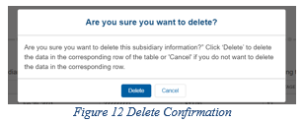
Key Editing Tips
Editing Data Entry:
Pencil Icon: click to amend any data input into a field.
Trash Bin Icon: click to delete any data input in a field. A confirmation pop-up will display prior to deletion:

Slide 10
NAVIGATION WITHIN THE PORTAL
After the successful login, users will be able navigate the portal through a series of pages in a sequential order – completing data entry for one step before proceeding to next.
The progress can be observed by viewing the progress bar located at the top of each portal page as shown on this slide.
Blue circle represents steps that are completed
White circle with blue outline represents currents steps
Gray circles represents steps to be completed

Slide 11
NAVIGATION WITHIN THE PORTAL
Users can save information on the current page and advance to the next step by clicking the blue ‘Save & Next’ button, only if all required data fields are entered correctly without errors.
Users can return to a previous page by clicking the blue ‘Previous’ button. Please note that clicking on ‘Previous’ button without saving the information will result in data loss.
Users should exit the portal when they are not actively entering data by clicking the red ‘Save & Exit’ button. Portal users should not exit the portal by closing the browser window or navigate away from the current page using the browser window as data entered on the current page will not be saved.
To re-enter the portal, users will be required to log in using the username, password, and a verification code sent to the email address on the record. The verification code will be valid for 15 minutes.
The portal will re-open on the first step (Entity Overview page) and all information previously saved will be evident. Click the blue ‘Save & Next’ button to navigate to the desired page to enter new data or correct any of the previously entered data fields.

Slide 12
NAVIGATION WITHIN THE PORTAL
Users can save partial information throughout the portal as long as they save the information on the current page by clicking on the blue ‘Save & Next’ or red ‘Save and Exit’ buttons as shown below.
Please note that the backward and forward navigation of the web browsers should not be used to navigate between steps. This will result in loss of data entered on the current page.

Slide 13
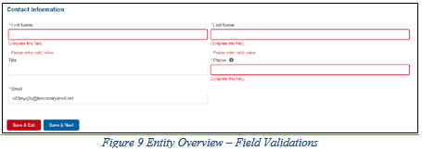
Key Tips
Resolving Error Messages: Missing fields must be completed in order to allow user to be able to advance to the next step.

Slide 14
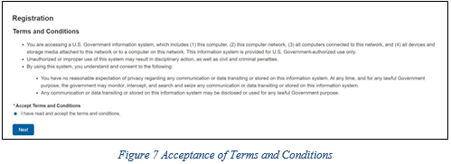
TERMS AND CONDITIONS
Certify that they have read and accept the PRF Reporting Portal Terms and Conditions by clicking on the radio button located to the left of the text ‘I have read and accept the terms and conditions.’
The ‘Next’ button will appear after the radio button is selected as shown below.

Slide 15
STEP 1: ENTITY OVERVIEW

Slide 16
STEP 1: ENTITY OVERVIEW
The first section of the page under the header ‘Entity Overview’ includes the following required fields:
Tax Identification Number (TIN): pre-populated
Business Name: pre-populated
Provider Type: not pre-populated
Provider Sub-Type: not pre-populated
Pre-populated fields cannot be change but a DBA Name (optional) may be added to the entity overview.

Slide 17
STEP 1: ENTITY OVERVIEW
Provider Type and Provider Sub-Type: use the dropdown menus to select the provider type/provider sub-type.
The sub-types are conditional to the Provider Types.
Select the combination that best describes the Reporting Entity’s type of business.
If multiple Provider Types or Provider Sub-Types apply, choose the pair that reflects the majority of the business.
After the Entity Overview information, the Address (as it appears on IRS Form W-9) and Contact Information sections are shown.
All of these data entry fields are pre-populated from registration.
If any information has changed since registration, the Reporting Entity should update the fields. Address data entry fields are all required and include: Street, State/Territory (selected from a drop-down list), City, and ZIP code (entered as 5 numeric digits).

Slide 18
STEP 1: ENTITY OVERVIEW
On this portal page, Reporting Entities should consider the following actions before saving:
Confirm the information in the Entity Overview and Address by using the same information on the IRS Form W-9.
Ensure the contact email address is a valid, monitored email address.
Ensure portal users are able to log in to the portal in the future and receive future communications regarding reporting, by adding ‘PRFReporting-NoReply@hrsa.gov to the safelist of the contact email provided during the registration and reporting process.
If any of the information is missing, an error message(s), similar to one shown in the next slide.

Slide 19
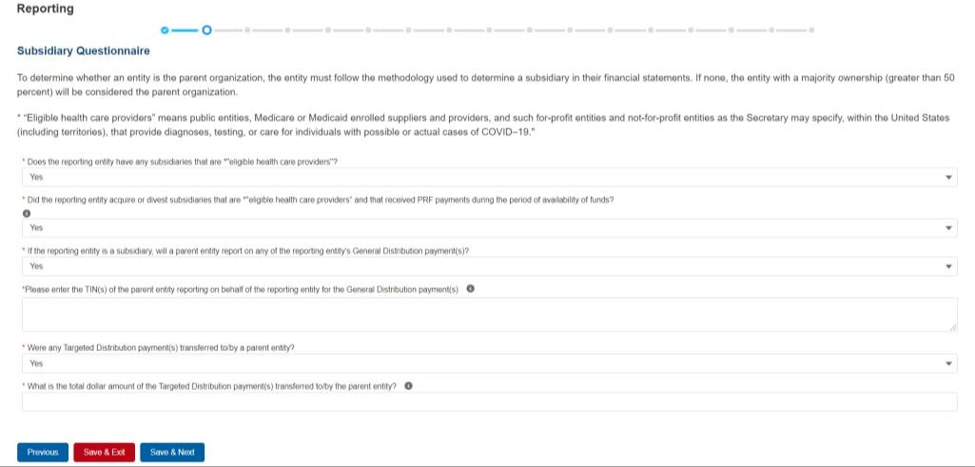
STEP 2: SUBSIDIARY QUESTIONNAIRE
There are four required questions with two conditional questions that may display based on the answers to the first four questions.
The Reporting Entity should answer all questions and click ‘Save & Next.’ If any of the questions are not completed, an error message ‘Complete this field.’ will appear in red under the missing field.

Slide 20
STEP 2: SUBSIDIARY QUESTIONNAIRE
The purpose of this page is to collect information about subsidiary entities for any Reporting Entities that are parent organizations and to collect information about parent entities for any Reporting Entities that are the subsidiary of a parent.
To determine whether an entity is the parent organization, the entity must follow the methodology used to determine a subsidiary in their financial statements.
If none, the entity with a majority ownership (greater than 50 percent) will be considered the parent organization.

Slide 21
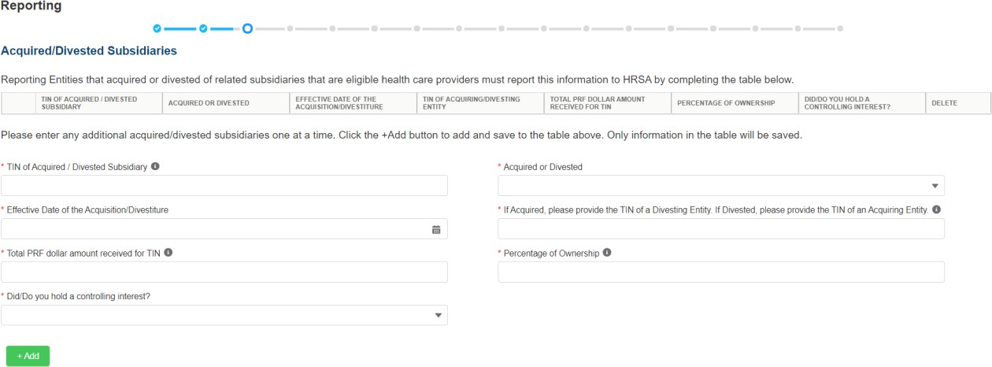
STEP 3: SUBSIDIARY DATA
Depending on the answers selected in Step 2 – Subsidiary Questionnaire, the Subsidiary Data page will render different data fields.
The Acquired/Divested Subsidiaries table below will be shown only if the Reporting Entity selected ‘Yes’ to the second question “Did the reporting entity acquire or divest subsidiaries that are eligible health care providers and that received PRF payments during the period of availability of funds?”

Slide 22
STEP 3: SUBSIDIARY DATA
The Acquired/Divested Subsidiaries Table will be blank and requires the Reporting Entity to complete it using the required input fields below the table.
Reporting Entities that acquired or divested related subsidiaries (change of ownership) during the period of availability must indicate the change in ownership.
Once all input fields are complete, the user should press the green ‘+Add’ button to populate the table. Upon clicking ‘+Add’, a number of data entry validations are run on the input fields.
If any errors occur, red messages will appear under the applicable input field.

Slide 23
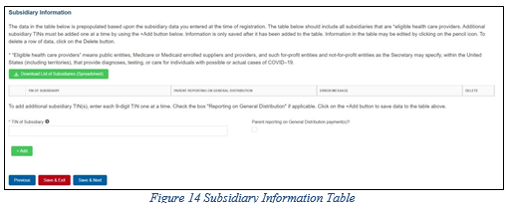
STEP 3: SUBSIDIARY DATA
The Subsidiary Information Table will be shown only if the Reporting Entity selected ‘Yes’ to the first question “Does the reporting entity have any subsidiaries that are *"eligible health care providers"?” on Step 2: Subsidiary Questionnaire

Slide 24
STEP 3: SUBSIDIARY DATA
The Subsidiary Information table will be prepopulated if one or more subsidiary TINs were provided during registration. If no subsidiary TINs were provided during registration, the table have a title row but will otherwise have no data.
Reporting Entities must complete the table by using the required input fields below the table.
Reporting Entities must add all subsidiaries that meet the definition of “eligible health care providers,” even if there is no General Distribution payment to report on and even if subsidiaries did not receive a PRF payment.
For the purposes of PRF reporting, “eligible health care providers” are defined as public entities, Medicare or Medicaid enrolled suppliers and providers, and such for-profit entities and not-for- profit entities as the Secretary may specify, within the United States (including territories), that provide diagnoses, testing, or care for individuals with possible or actual cases of COVID–19.

Slide 25
STEP 3: SUBSIDIARY DATA
To add a subsidiary to the table, the Reporting Entity must enter a 9-digit TIN; and, if applicable, check the box “Parent reporting on General Distribution payment(s)?”.
Reporting Entities have the option to download a list of subsidiaries as a spreadsheet after completing the table by clicking the ‘Download List of Subsidiaries (Spreadsheet).’ This summary can be used to confirm the correct TIN(s) of subsidiaries have been entered.
Critical to double check on the subsidiary table because HHS will only recognize reporting on subsidiaries’ PRF payment if this entry matches the TIN of the HHS PRF distribution.
Reporting on General Distribution Payments of Subsidiaries:
Users should add a ‘TIN of Subsidiary’ into the table using the input fields, by selecting if the TIN is a “Parent reporting on General Distribution payment(s)?” and pressing the green ‘+Add’ button.
The TIN will be inserted into the table and automatically validated against HRSA’s PRF payment file.
If the subsidiary TIN did not receive a PRF payment in the corresponding Payment Received Period, the message "TIN not found in the PRF payment file” is shown in the ‘Error Message’ column.

Slide 26
STEP 4: PAYMENTS TO RECIPIENT
The user is directed to the Payments to Recipient page after successfully completing Step 3: Subsidiary Data or if they answered ‘No’ to the following questions in Step 2: Subsidiary Questionnaire:
Does the reporting entity have any subsidiaries that are "eligible health care providers"?
Did the reporting entity acquire or divest subsidiaries that are eligible health care providers and that received PRF payments during the period of availability of funds?
The tables of information presented in Step 4: Payments to Recipients highlight the payments made to the Reporting Entity (and its subsidiaries, if applicable) within the Payment Received Period that corresponds to the current Reporting Period as shown in Table 1 Reporting Periods. Information is pre-populated, including the type of distribution.

Slide 27
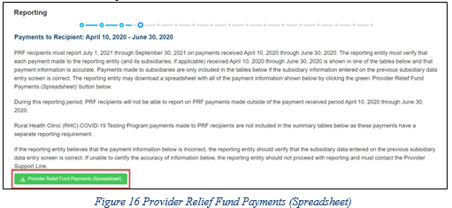
STEP 4: PAYMENTS TO RECIPIENT
The user may download a spreadsheet with all payment information shown on this page by clicking the green ‘Provider Relief Fund Payments (Spreadsheet)’ button as shown below.
This functionality is intended to assist portal users in reconciling the payment amounts for the reporting period and the download is recommended but not required.

Slide 28
STEP 4: PAYMENTS TO RECIPIENT
The tables displayed on this portal page summarize all payments made during the Payment Received Period corresponding to the Reporting Period:
Total Nursing Home Infection Control Payments (includes Quality Incentive Program (QIP) payments)
Total Other PRF Payments (i.e., all General Distribution payments and Other Targeted Distribution Payments)
Total Rejected Payments (Attestation Rejected).⁷ Rejected payments are not included in the total payments on which Reporting Entities are required to report.

Slide 29
STEP 4: PAYMENTS TO RECIPIENT
Each table on the Payments to Recipient page will have column headers and payment information if a payment was received during the corresponding Payment Received Period.
The payment period summary table can be used to confirm for each payment:
TIN of recipient
distribution type
dollar amount deposited (i.e., amount of original payment)
dollar amount returned (by recipient)
dollar amount retained (calculated as amount deposited – amount returned)
attestation date.
The Attestation Date field will be blank if the attestation was accepted by default.

Slide 30
STEP 4: PAYMENTS TO RECIPIENT
Nursing Home Infection Control payments are separated from all General Distribution and other Targeted Distribution payments because the funds may only be used for specific purposes as indicated in the payment Terms and Conditions.
Reporting Entities will report on the expenses for the Nursing Home Infection Control payments separately from expenses for other payments.
The Reporting Entity must certify the accuracy of the information at the bottom of this page before preceding to the next step of reporting. If the information is accurate, users must select ‘Yes’ and click the ‘Save & Next’ button as shown below.

Slide 31
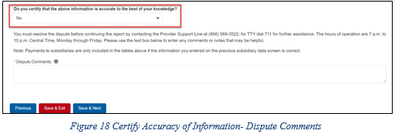
STEP 4: PAYMENTS TO RECIPIENT
If the information is not accurate, portal users should select ‘No’ and provide a description of the reason the information is inaccurate in the ‘Dispute Comments’ data entry field as shown below.
The Reporting Entity must enter a text narrative in the Dispute Comments field and click ‘Save & Next’.
The portal user is then asked to call the Provider Support Line to resolve the incorrect payment data.
The Reporting Entity must resolve the dispute as soon as possible as they will be unable to proceed to the next step in the reporting process until the dispute is resolved.

Slide 32
STEP 4: PAYMENTS TO RECIPIENT
Once providing dispute comments and clicking ‘Save& Next’, the user will see the pop-up as displayed below.
The Reporting Entity will be able to proceed with the reporting process only after the user is able to certify the accuracy of the information on this portal page.
If a Reporting Entity certifies that the information on this portal page is accurate but has not received PRF payments exceeding $10,000 in the aggregate during the Payment Received Period corresponding to the Reporting Period as shown in Table 1 Reporting Periods, the reporting process will not proceed and the user will receive a pop-up message as shown on next slide.

Slide 33
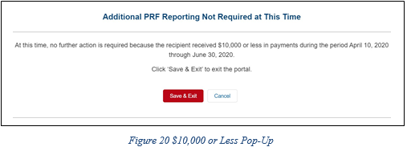
STEP 4: PAYMENTS TO RECIPIENT
Reporting Entities will not be able to report on the use of funds if their payments during the Payment Received Period do not exceed $10,000 in the aggregate.
Users should click ‘Save & Exit’ to return back to the Reporting Portal Home Page if they are not required to report.

Slide 34
STEP 5 : INTEREST EARNED ON PRF PAYMENTS, TAX INFORMATION, AND SINGLE AUDIT INFORMATION

Slide 35
STEP 5 : INTEREST EARNED ON PRF PAYMENTS, TAX INFORMATION, AND SINGLE AUDIT INFORMATION
If interest is earned on PRF payments received in the Payment Received Period corresponding to the current reporting period, interest must be applied toward a reportable use of funds through allowable expenses or lost revenues..
Interest should be calculated from the date the payment was received until the date of expenditure (or the date of return in the case of unused PRF payments).
Interest must be broken down into two categories:
total amount of interest earned on Nursing Home Infection Control payments (if applicable)
total amount of interest earned on all other PRF payments
The total amount of interest reported must be a number with up to two decimal points
A zero (0) value must be entered if the PRF payments were not held in an interest-bearing account or if no interest was earned on the payments.

Slide 36
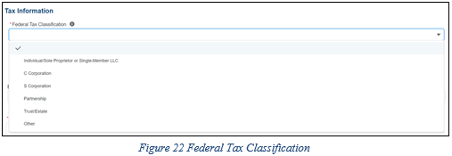
STEP 5 : INTEREST EARNED ON PRF PAYMENTS, TAX INFORMATION, AND SINGLE AUDIT INFORMATION
The Reporting Entity must select from a dropdown list to choose the federal tax classification, the designated business type associated with the Reporting Entity’s primary TIN used for filing taxes.
Federal tax classification may be reported as Individual/Sole proprietor or Single-Member LLC, C Corporation, S Corporation, Partnership, Trust/Estate, or Other.
If the Reporting Entity selects ‘Other,’ a new data entry field will appear and the Reporting Entity will have to specify the designated business type as shown below.

Slide 37
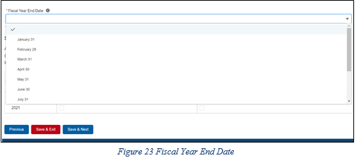
STEP 5 : INTEREST EARNED ON PRF PAYMENTS, TAX INFORMATION, AND SINGLE AUDIT INFORMATION
The Reporting Entity must select from the dropdown list the Fiscal Year End Date that accurately matches the month in which the Reporting Entity reports its fiscal year financial results as shown below
If the fiscal year end date has changed, the Reporting Entity should enter the fiscal year end date applicable at the time of reporting.

Slide 38
STEP 5 : INTEREST EARNED ON PRF PAYMENTS, TAX INFORMATION, AND SINGLE AUDIT INFORMATION
Recipients that expend a total of $750,000 or more in federal funds (including PRF payments and other federal financial assistance) during their fiscal year are subject to Single Audit requirements, as set forth in the regulations at 45 CFR § 75 Subpart F.
Non-federal entities must have a Single Audit conducted in accordance with 45 CFR § 75.514 that must be submitted electronically to the Federal Audit Clearinghouse.
Commercial organizations have two options under 45 CFR § 75.216(d) and § 75.501(i)
a financial related audit of the award or awards conducted in accordance with Generally Accepted Government Auditing Standards
an audit in conformance with the requirements of 45 CFR § 75.514 - Single Audit).
Audit reports of commercial organizations must be submitted via email to HRSA’s Division of Financial Integrity at PRFaudits@hrsa.gov.

Slide 39
STEP 6: PAYMENTS SUMMARY

Slide 40
STEP 6: PAYMENTS SUMMARY
Pre-populated based on the Reporting Entity’s answers to previous questions and payments received during the Payment Received Period which corresponds to the current Reporting Period/
Review the dollar amounts shown and click ‘Save & Next’ if all amounts are correct.
If the payment information does not appear correct, the Reporting Entity should navigate to the previous pages and correct previous data input. ensure that data was entered correctly.
Payments received by the Reporting Entity and/or its subsidiaries outside of the current reporting period or where the attestation for the payment was rejected.

Slide 41
STEP 7: OTHER ASSISTANCE RECEIVED

Slide 42
STEP 7: OTHER ASSISTANCE RECEIVED
Reporting Entities must report other related assistance received by the Reporting Entity (and its subsidiaries included in reporting as applicable) during the period of availability that corresponds to the current reporting period.
The information reported in this table is not used in subsequent calculations in the portal; including expenses or lost revenues.
All cells are required data entry fields, and entries are restricted to 14 digits including up to 2 decimals
Negative numbers may not be entered. If zero, the reporting entity must enter a ‘0.’
If the Reporting Entity is reporting on behalf of subsidiaries, the assistance received for each category must be aggregated across each of the subsidiaries included in the report.
KEY REMINDER: Reporting Entities are expected to make a determination of their expenses applied to PRF payments after considering Other Assistance Received and taking into account that PRF payment may not be used for expenses or lost revenues that other sources have reimbursed or that other sources are obligated to reimburse.

Slide 43
STEP 7: OTHER ASSISTANCE RECEIVED
The Reporting Entity must enter other assistance received by calendar year quarters in the period of availability of funds for the payments received in the Payment Received Period that corresponds to the current reporting period. Calendar year quarters are defined as follows:
Quarter 1 (Q1): January 1 – March 31
Quarter 2 (Q2): April 1 – June 30
Quarter 3 (Q3): July 1 – September 30
Quarter 4 (Q4): October 1 – December 31

Slide 44
STEP 7: OTHER ASSISTANCE RECEIVED
Other Assistance Received will be reported for the period of availability by calendar year quarter for the Reporting Entity (and its subsidiaries included in reporting) as follows:
Department of the Treasury (Treasury) and/or Small Business Administration (SBA) Assistance: Total amount of coronavirus-related relief received from Treasury and/or SBA, including the Paycheck Protection Program, by the Reporting Entity during the period of availability.
Federal Emergency Management Agency (FEMA) Programs: Total amount of coronavirus related relief received from FEMA by the Reporting Entity during the period of availability.
HHS CARES Act Testing: Total amount of relief received from HHS by the Reporting Entity for coronavirus testing-related activities during the period of availability.
Local, State, and Tribal Government Assistance: Total amount of coronavirus- related relief received by the Reporting Entity from other Local, State, or Tribal government sources during the period of availability.
Business Insurance: Paid claims against insurance policies intended to cover losses related to various types of health care business interruption during the period of availability.
Other Assistance: Total amount of other federal and/or coronavirus-related assistance received by the Reporting Entity during the period of availability.

Slide 45
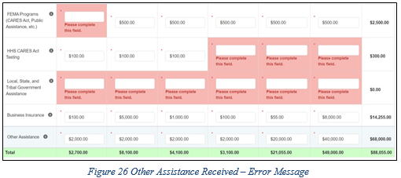
STEP 7: OTHER ASSISTANCE RECEIVED
An error message in red will appear if the required fields are missing information or are not formatted properly as shown below.
Automated calculations will appear by row and column.

Slide 46
STEP 8: NURSING HOME INFECTION CONTROL EXPENSES FOR PAYMENTS RECEIVED DURING PAYMENT PERIOD
Reporting Entities that received between $10,001 and $499,999 in aggregated PRF payments during the Payment Received Period are required to report by calendar quarter on the use of Nursing Home Infection Control Distribution payments in two categories: (1) General and Administrative (G&A) Expenses and (2) Healthcare Related Expenses as shown below.

Slide 47
STEP 8: NURSING HOME INFECTION CONTROL EXPENSES FOR PAYMENTS RECEIVED DURING PAYMENT PERIOD
After Step 7: Other Assistance Received is complete, the Reporting Entity is directed to report on the use of Nursing Home Infection Control Distribution payments received during the Payment Received Period that corresponds to the current Reporting Time Period.
If the Reporting Entity did not receive Nursing Home Infection Control Payments during the applicable Payment Received Period, this page will be skipped and the user will be taken directly to Step 9: Other PRF Expenses for Payments Received During Payment Period.
The Reporting Entity will report on the use of all Nursing Home Infection Control Distribution (including QIP) payments by entering the calendar year quarterly expenses unreimbursed by other sources and that other sources were not obligated to reimburse that were applied to these payments.
Expenses must be reported by calendar year quarter; defined as follows:
Quarter 1 (Q1): January 1 – March 31
Quarter 2 (Q2): April 1– June 30
Quarter 3 (Q3): July 1– September 30
Quarter 4 (Q4): October 1 – December 31

Slide 48
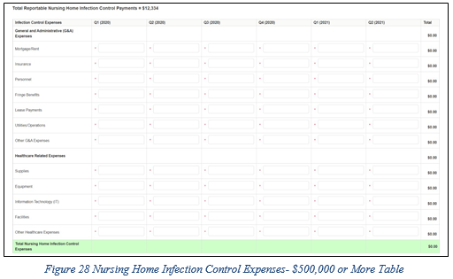
STEP 8: NURSING HOME INFECTION CONTROL EXPENSES FOR PAYMENTS RECEIVED DURING PAYMENT PERIOD
Reporting Entities that received $500,000 or more in aggregated PRF payments during the Payment Received Period are required to report by calendar year quarter on the use of Nursing Home Infection Control Distribution payments in greater detail than the two categories of General and Administrative (G&A) Expenses and Healthcare Related Expenses as shown below.

Slide 49
STEP 9: OTHER PROVIDER RELIEF FUND EXPENSES FOR PAYMENTS RECEIVED DURING PAYMENT PERIOD
For entities that received between $10,001 and $499,999 in aggregated PRF payments, reporting is entered in two main categories:
General and Administrative (G&A) Expenses
Healthcare Related Expenses

Slide 50
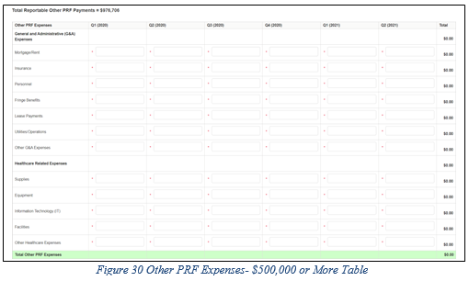
STEP 9: OTHER PROVIDER RELIEF FUND EXPENSES FOR PAYMENTS RECEIVED DURING PAYMENT PERIOD
For recipients that received $500,000 or more in aggregated PRF payments during the Payment Received Period are required to report their General and Administrative (G&A) Expenses and Healthcare Related Expenses in greater detail:

Slide 51
STEP 10: UNREIMBURSED EXPENSES ATTRIBUTABLE TO CORONAVIRUS
On this worksheet, the Reporting Entity is required to report on the net unreimbursed expenses attributable to coronavirus (net after other assistance received and PRF payments are applied) by indicating the calendar year quarterly expenses during the period of availability of the Payments Received that correspond to the current reporting period.
Expenses are reported in two categories: (1) General and Administrative (G&A) Expenses and (2) Healthcare Related Expenses as shown in the table below.

Slide 52
STEP 10: UNREIMBURSED EXPENSES ATTRIBUTABLE TO CORONAVIRUS
On this worksheet, the Reporting Entity is required to report on the net unreimbursed expenses attributable to coronavirus that have not been reimbursed by other sources and that other sources are not obligated to reimburse.
The net unreimbursed expenses attributable to coronavirus reported to HRSA will not be used in the calculation of expenses or lost revenues.
Reporting Entities are expected to determine whether there are net unreimbursed expenses attributable to coronavirus after taking into consideration the application of Other Assistance Received and all PRF payments.
HRSA expects that Provider Relief Fund payments would be applied to unreimbursed expenses attributable to coronavirus before Provider Relief Fund payments are used for lost revenues.

Slide 53
STEP 11 or 12: ACTUAL PATIENT CARE REVENUE OR LOST REVENUES
Depending on data from previous pages, the portal will display one of two input slides:
Actual Patient Care Revenue: will display if the expenses are equal to or exceed the PRF payments.
Lost Revenue Questionnaire: will display if PRF payments have not been totally offset be expenses.
If the Reporting Entity is show the Actual Patient Care Revenue page, complete the inputs and the portal will direct you to Step 13: PRF Financial Summary Page.

Slide 54
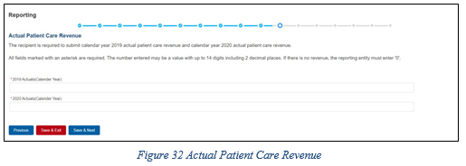
STEP 11 or 12: ACTUAL PATIENT CARE REVENUE OR LOST REVENUES
Actual Patient
Care Revenue:
Lost Revenues
Questionnaire:

Slide 55
STEP 12: LOST REVENUE QUESTIONNAIRE
Lost Revenues Questionnaire: choose the method for reporting lost revenues:
Option 1: 2019 Actual Revenue: The difference between actual patient care revenues (uses 2019 calendar year quarters as the baseline); or
Option ii: 2020 Budgeted Revenue: The difference between budgeted (prior to March 27, 2020) and actual patient care revenues (uses 2019 calendar year quarters as the baseline); or
Option iii: Alternate Reasonable Methodology: Calculated by any reasonable method of estimating revenues.

Slide 56
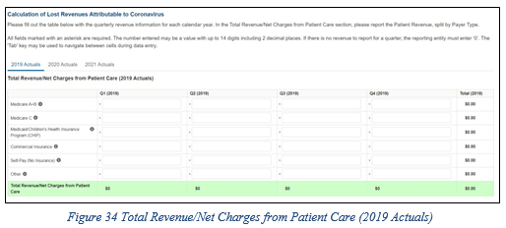
STEP 12: LOST REVENUE QUESTIONNAIRE
Option i: using 2019 Actual Revenue method, the page below will appear:

Slide 57
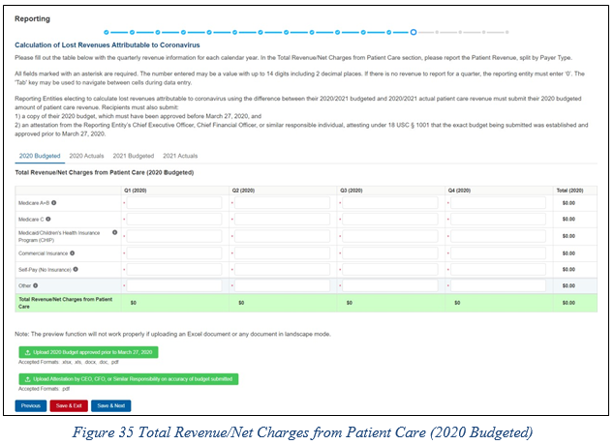
STEP 12: LOST REVENUE QUESTIONNAIRE
Option ii: using 2020 Budget method, the page below will appear:

Slide 58
STEP 12: LOST REVENUE QUESTIONNAIRE
In addition to completing four tables with budgeted and actuals for total revenue/net charges from patient care, Reporting Entities that select this method of calculating lost revenues must submit the following documentation:
A copy of the 2020 budget approved prior to March 27, 2020.
The budget must be submitted in one of the following accepted file formats: .xlsx, .xls, .docx, .doc, or .pdf.
Attestation by a Chief Executive Officer (CEO), Chief Financial Officer (CFO), or other similarly responsible individual representing the Reporting Entity on the accuracy of the budget submitted. The attestation must be submitted in a .pdf file format.
The attestation should state that the budget was established and approved prior to March 27, 2020, be submitted on organizational letterhead, and include a signature and complete contact information.

Slide 59
STEP 11: ACTUAL PATIENT CARE REVENUE OR LOST REVENUES
Documentation must be uploaded by clicking the green ‘Upload’ buttons as shown in the figure on next slide.
Once uploaded, the name of the attachment will be displayed to the right of the ‘Upload’ button and the documentation may be previewed to ensure it has been submitted correctly.
Portal users may also download or remove previously uploaded documentation.
In order to preview documents in .pdf format, the latest version of Adobe Acrobat Reader must be installed.

Slide 60
STEP 12: LOST REVENUE QUESTIONNAIRE
If a data entry field has not been completed, has an invalid value, or if a required document is not uploaded, a red error message will appear directing the user to correct the error.

Slide 61
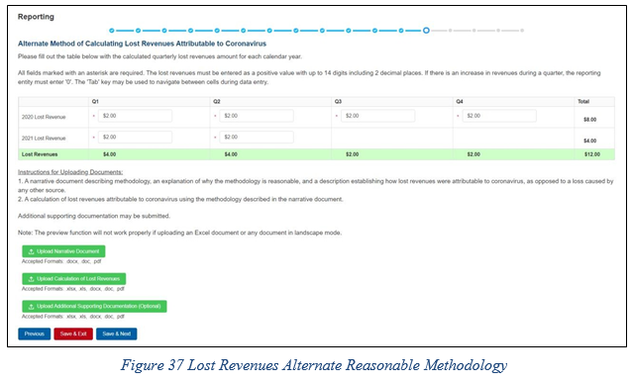
STEP 12: LOST REVENUE QUESTIONNAIRE
Option iii: using Alternate Reasonable Methodology, the page below will appear:

Slide 62
STEP 12: LOST REVENUE QUESTIONNAIRE
Reminder that any recipient using an alternate methodology for reporting lost revenue will face an increased likelihood of audit.
HRSA will notify a Reporting Entity if their proposed methodology is not reasonable, including if it does not demonstrate with a reasonable certainty that claimed lost revenues were caused by coronavirus.
If HRSA determines that a Reporting Entity’s proposed alternate methodology is not reasonable, HRSA will require the Reporting Entity to resubmit its report within 30 days of notification using one of the other options to calculate lost revenues attributable to coronavirus (i.e., Actuals or Budgeted).

Slide 63
STEP 12: LOST REVENUE QUESTIONNAIRE
Reporting Entities selecting the alternate reasonable methodology are required to submit additional documentation, with maximum file size of 2GB, as follows:
Narrative Document: The narrative document must describe the methodology, an explanation of why the methodology is reasonable, and a description establishing how lost revenues were attributable to coronavirus (as opposed to a loss caused by any other source). Acceptable file formats for the narrative document are .docx, .doc, or .pdf.
Calculation of Lost Revenues: The calculation of lost revenues attributable to coronavirus must use the methodology described in the Narrative Document described above. Acceptable file formats for the calculation of lost revenues documentation are.xlsx, .xls, .docx, .doc, or .pdf.
Optional: Additional Supporting Documentation: One file of additional documentation may be submitted. Acceptable file formats for the supporting documentation are: .xlsx, .xls, .docx, .doc, or .pdf.

Slide 64
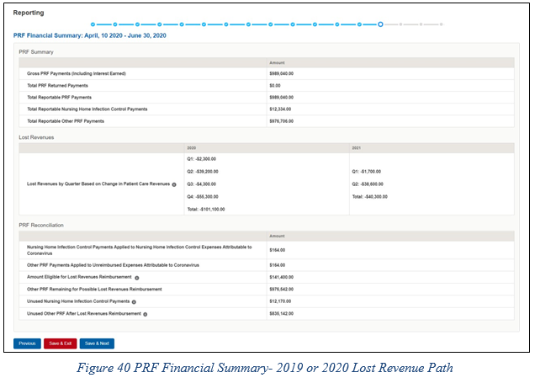
STEP 13: PRF FINANCIAL SUMMARY
The Step 13: PRF Financial Summary page displays pre-populated values based on calculations from data entered during the reporting process as shown below and on the next slide.

Slide 65
STEP 13: PRF FINANCIAL SUMMARY

Slide 66
STEP 14: PERSONNEL, PATIENT, AND FACILITY METRICS
The Personnel, Patient, and Facility Metrics page is comprised of three tabs, each with its own table(s) which will capture different metrics, but:
All cells are required
Restricted to eight digits with no decimals
Must be positive values.
You can move between the tabs and tables without losing data, however, the data on this page will not be saved until the data entry is complete and the blue ‘Save & Next’ button is selected.

Slide 67
STEP 14: PERSONNEL, PATIENT, AND FACILITY METRICS
The Personnel Metrics data tables will require Reporting Entities to calculate a total number of people employed (across all TINs included in the reporting) by labor category for all clinical and non-clinical staff, by quarter.
Reporting Entities will include metrics for personnel for calendar year 2019 through the end of the period of availability of the funds on which the provider is reporting.
Personnel numbers should be reported here whether or not their salaries and/or benefits were paid using the PRF payments included in the reporting.

Slide 68
STEP 14: PERSONNEL, PATIENT, AND FACILITY METRICS

Slide 69
STEP 14: PERSONNEL, PATIENT, AND FACILITY METRICS
Definitions of personnel metrics are as follows:
Clinical: Total number of clinical personnel providing direct patient care by labor category (full time, part time, contract, furloughed, separated, hired). Personnel must be categorized as clinical if 50% or more of their time is spent delivering direct patient care.
Non-Clinical: Total number of non-clinical personnel by labor category (full time, part time, contract, furloughed, separated, hired). Personnel must be categorized as non- clinical if less than 50% of their time is spent delivering direct patient care.
Full-time: Number of personnel employed on average 30 hours of service per week, or 130 hours for a calendar month. However, health care practices may have exceptions to this, such as nursing shifts.
Part-time: Number of personnel employed any time between 1 and 34 hours per week, whom may or may not qualify for benefits.
Contractor: Number of personnel employed as an individual or under organizational contracts and do not receive direct benefits or compensation from the employer/provider.
Furloughed: Number of personnel on temporary involuntary and unpaid leave of absence.
Separated: Number of personnel who 1) voluntarily submit a written or verbal notice of resignation or 2) the employer/provider decided to terminate its relationship with the employee(s) (includes lay-offs and expired contracts).
Hired: Number of personnel 1) not previously employed by the employer or 2) that left an employer due to voluntary or involuntary separation and are brought back to work by employer.

Slide 70
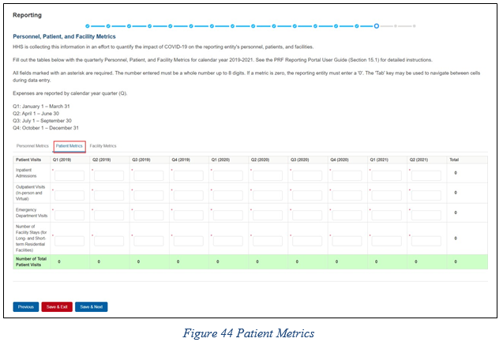
STEP 14: PERSONNEL, PATIENT, AND FACILITY METRICS
The Patient Metrics tab is comprised of one table in the figure below.

Slide 71
STEP 14: PERSONNEL, PATIENT, AND FACILITY METRICS
Definitions of patient metrics are as follows:
Inpatient Admissions: Number of hospital admissions on a clinician’s order (i.e., direct admit) or formally admitted from the emergency department to the hospital (i.e., emergency admission).
Outpatient Visits (in-person and virtual): Number of in-person or virtual patient encounters with a clinician in an office-based, clinic, or hospital outpatient department setting that do not require an inpatient admission.
Emergency Visits: Number of emergency department encounters for care or treatment. This may include patients on observation status who are cared for no longer than 72 hours and not formally admitted to a hospital.
Facility Stays (for Long- and Short-term Residential Facilities): Number of stays (defined as unique admissions) for patients residing in a long-term or short-term care or treatment facility.

Slide 72
STEP 14: PERSONNEL, PATIENT, AND FACILITY METRICS
The Facility Metrics tab is comprised of a required question ‘Does the Reporting Entity or its subsidiaries operate or support staffed beds?’
A staffed bed is defined as a licensed and physically available bed with staff on hand to attend to patients; includes both occupied and available beds.
If the answer to the question is ‘No,’ and the Personnel and Patient Metrics tables are complete, the user may click the blue ‘Save & Next’ button to proceed to the next page.
If the answer to the question is ‘Yes,’ an additional table will need to be completed as shown in the figure on the next slide.

Slide 73
STEP 14: PERSONNEL, PATIENT, AND FACILITY METRICS

Slide 74
STEP 14: PERSONNEL, PATIENT, AND FACILITY METRICS
Definitions of facility metrics are as follows:
Medical/Surgical Beds: Number of general medical/surgical beds, which are the beds used for routine care or “ward” beds.
Critical Care Beds: Number of beds in intensive care units (ICUs), critical care units (CCUs) or intensive therapy units (ITUs).
Other Beds: Number of any other type of staffed bed that the facility has physically available and licensed to operate.

Slide 75
STEP 15:SURVEY
Step 15: Survey is the last data entry page in the report and is included to evaluate the impact of PRF payment(s) on the Reporting Entity’s financial and clinical care situation during the period of availability of funding that corresponds to the current reporting period.
The survey consists of two sections:
Financial effects of PRF payment(s)
Clinical care effects of PRF payment(s)
A response will be selected from the dropdown list as follows: ‘Strongly Agree,’ ‘Agree,’ ‘Neutral,’ ‘Disagree,’ or ‘Strongly Disagree.’
If the respondent selects ‘Strongly Agree’ or ‘Agree’ to this question an additional question will be required.

Slide 76
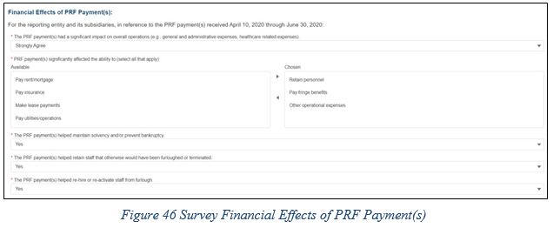
STEP 15:SURVEY
Financial Effects:

Slide 77
STEP 16: REVIEW AND SUBMIT
A summary of all data entered in the report will display once all the data entry on prior pages is completed.
Data on this page cannot be edited, but if the portal user sees an error, they should navigate back to the appropriate page using the blue ‘Previous’ button.
Once the report is submitted, the Reporting Entity will no longer be able to edit the report.
If the report on the use of funds indicates that the Reporting Entity (or its subsidiaries as applicable) has unused PRF payments for the applicable period, you will be directed in red text to follow the instructions located on the PRF website to return unused PRF payments.

Slide 78
STEP 16: REVIEW AND SUBMIT
The Reporting Entity is presented with the following questions for response:
Did you report on the use of your Rural Health Clinic COVID-19 Testing funds in the RHC portal? Select “Yes’ or “No’ from the dropdown list.
Do you certify that the above information is accurate to the best of your knowledge?
If ‘No’ is selected, the Reporting Entity will see the following message: ‘Please click on the ‘Previous’ button at the bottom of the page to go back to correct the inaccurate data.’
If ‘Yes’ is selected, the Reporting Entity may click the blue ‘Submit’ button.

Slide 79
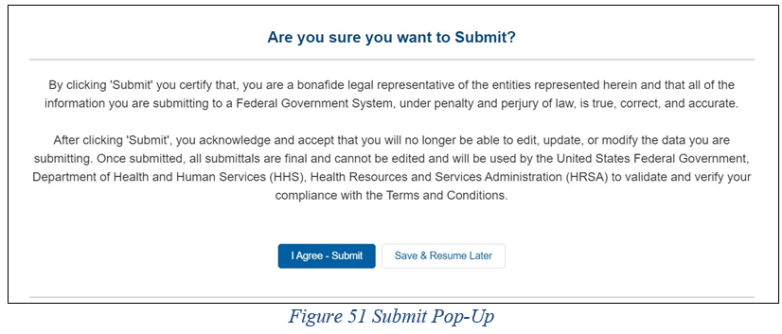
STEP 16: REVIEW AND SUBMIT
If the data is correct, and the user clicks the blue ‘Submit’ button, a pop-up message will appear as shown in the figure below.

Slide 80
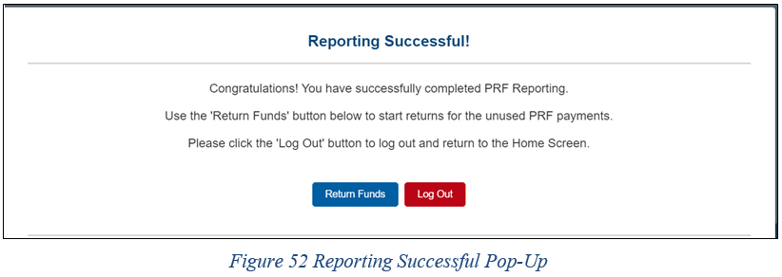
STEP 16: REVIEW AND SUBMIT
Once the ‘Submit’ button is clicked, a pop-up will appear confirming the submission was made as shown in the figure below.

Slide 81
STEP 16: REVIEW AND SUBMIT
Upon submission of the report, the Reporting Entity will receive a confirmation email from ‘PRFReporting-NoReply@hrsa.gov.’
If the Reporting Entity has any of the following, additional information will also be provided in the email:
Received additional PRF payments in other Payment Received Periods
Has indicated that they have not reported on the use of RHC COVID-19 Testing Program or RHC COVID-19 Testing and Mitigation Program funds
Has unused PRF payments from the Payment Received Period corresponding to the current reporting period.

Slide 82
STEP 16: REVIEW AND SUBMIT

Slide 83
Wrap Up & Questions
The webinar & slide deck will be uploaded to our website shortly:
https://shpllc.com/webinars
You can ask a question in the chat .
Or, if you wish to be unmuted, please raise your hand & and a moderator will enable your microphone.
1
2
3

