Slide 1
Establishing a Managed Care Strategy
Presentation: Southeastern Association of Orthopaedic Executives
Date: Sept. 9, 2023

Slide 2
Strategic Healthcare Partners, LLC – Who We Are and Who We Serve
Founded by Principals John Crew and Mike Scribner in 2009.
Over 30 years experience in the field.
Broad spectrum of healthcare clients including:
35+ hospitals
Over 1,000 physicians/extenders
IPAs/CINs, ASCs,
All 22 of the community mental health centers in Georgia.
Specializing in rural healthcare providers; experience in working in HPSA designated areas.
Notes:
Strategic Healthcare Partners was founded by Principals John Crew and Mike Scribner in 2009.
SHP brings over 30 years experience fighting alongside rural/smaller healthcare providers to ensure ongoing viability and success.
SHP serves a broad spectrum of healthcare clients; including 35+ hospitals, over 1,000 physicians/extenders, IPAs/CINs, ASCs, and all 22 of the community mental health centers in Georgia.
- ASC Services include contract negotiation, managed care strategic planning, financial analysis, supply chain analysis, and revenue cycle analytics.

Slide 3
Agenda
Overall Managed Care Strategy
Medicare Advantage & Your Practice
Monitoring Payer Performance
Vetting New Carriers / Payers
Contract Negotiation / Renegotiation Best Practices
Wrap Up

Slide 4
Overall Managed Care Strategy

Slide 5
MA Issues vs. Overall Managed Care Strategy
Typically, the carriers offering MA products also offer commercial (small group/large group), Health Exchange, and Medicaid products in the market.
Understanding carrier goals around other product lines and your issues with those products plays in to practice/ASC response.
Real Examples:
ASC with exceptional % of charge Anthem commercial agreement (35% of payer mix vs. 2% Anthem MA product. Little motivation to fight MA issues.
Practice/ASC with many Humana/UHC MA issues receives Medicaid managed care proposal. Response- No consideration of Medicaid until MA record requests/claim issues are resolved.

Slide 6
Georgia Market Example
No Such Thing as a Commercial Only Carrier
All major carriers offer multiple product lines and, for the most part want to expand their presence in each/grow to others.

Slide 8
Medicare Advantage- The Big Picture

Slide 9
Medicare Advantage- National Perspective
Fastest growing healthcare population
Medicare provides health insurance coverage for 65 million beneficiaries
By 2060, projections estimate that this number will increase to 93 million and will account for 23% of the total US population
In 2023, the Medicare population became evenly split between traditional Medicare and Medicare Advantage enrollment.
By 2033, projected that 62% of eligible Medicare beneficiaries will be enrolled in a Medicare Advantage plan.
CBO estimates MA plans pay 3% LESS than traditional Medicare to providers.
Scarcity of rural providers and low patient volume in rural areas is less appealing for MA plans.
Network adequacy standards hinder MA competition in rural markets (both good and bad for providers).
Notes:
https://www.beckershospitalreview.com/payer-issues/medicare-advantage-growth-among-top-5-commercial-payers.html

Slide 10
Medicare Advantage National Trends
 | FY2023 MA Membership | Percentage Growth (FY 2010 vs FY 2023)
Aetna | 3.3 million | 532%
Anthem | 4.3 million | 264%
Humana | 5.5 million | 316%
Cigna | 573 thousand | 178%
United Healthcare | 8.9 million | 415%
Kaiser Permanente | 1.8 million | 199%
Centene | 1.2 million | 188%
Notes:
https://www.kff.org/medicare/issue-brief/medicare-advantage-in-2023-enrollment-update-and-key-trends/

Slide 11
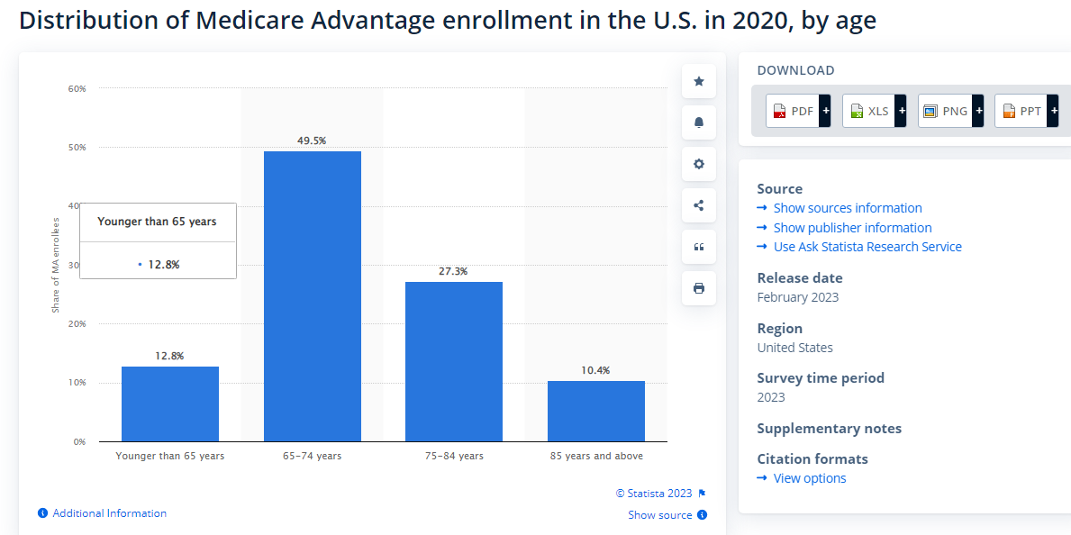
What is Driving the Trend?
Notes:
https://www.statista.com/statistics/1380847/medicare-advantage-enrollment-by-age-in-the-us/

Slide 12
What is Driving the Trend?
Health Plans:
In 2023, 8 new payors entered the market for the first time.
Two of the new firm entrants are offering plans in California, and the remainder are offering plans in Arizona, Connecticut, Iowa, Idaho, Massachusetts, and Missouri.
Attractive growth market for health plans - Medicare spending for Medicare Advantage enrollees was $321 higher per person in 2019 than if enrollees had instead been covered by traditional Medicare.
Medicare Beneficiaries:
Rapidly growing population is a key indicator driving growth.
Incoming Medicare eligible beneficiaries are more familiar with managed care plans and look for options that mirror their traditional health coverage.
Definitely attractive to the younger Medicare eligible block.
MA plans exploded when $0 premium plan options became prevalent. Enrollment via signature w/o payment.

Slide 13
Medicare Trends
Rapid proliferation of health plan options via Medicare Advantage
In 2023, the average Medicare beneficiary can choose from 43 different Medicare Advantage plans, double the number available 5 years ago.
What Types of Plans are Offered:
HMOs: 58% of all offerings
Local PPOs: 40%
Regional PPOs/PFFS plans: declined to 1% by 2023

Slide 14
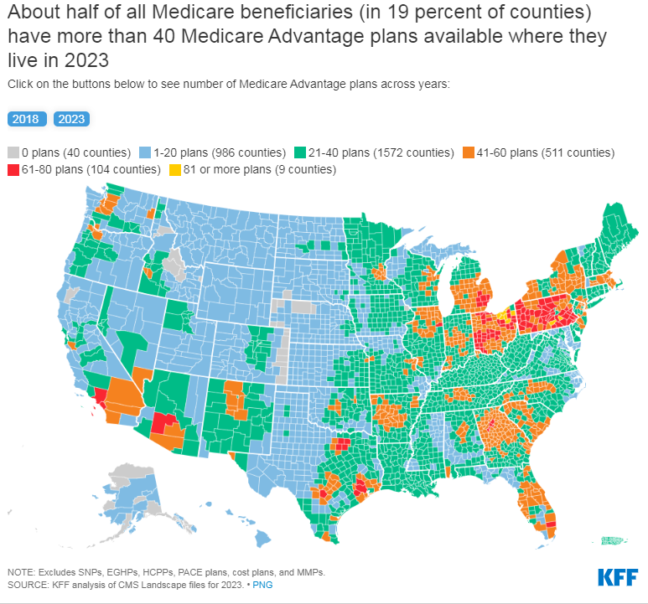
Medicare Trends

Slide 15
Summary of Trends
This stuff ain’t going away; it’s going to grow, both in plan membership and in number of different carriers/plans involved.
Inevitably, there will be carrier consolidation (ala commercial market) but a zillion players right now.
Regulatory support has been garbage; we have to defend ourselves.
Value based $’s might even out the game for primary care but not for specialists/ASCs (well, any time soon….).

Slide 16
Medicare Advantage & Your Practice

Slide 17
MA Plan Administrative Burden- Impact on Provider
As plans continue to proliferate with little to no regulatory oversight, so does the overwhelming bureaucracy:
Same population of patients = endless variation of provider manuals & policies
Prior Authorizations
Appeals
Claims Payment Methodology
Carve-Out Vendors
Record Requests
Commercial policies applied to Medicare beneficiaries
Death by Medical Record Request- Lead by UHC and Humana
UHC MA plus Humana MA, typically 15-20% of ASC payer mix; Likely 75% of chart requests.
Gambling for lack of ASC response leading to technical denial.
Provider examples of 100% approval rate post record submission…still not leading to fewer requests.

Slide 18
MA Plan Burden- Impact on Member
Patient Confusion
How do I purchase the right plan?
How do I navigate my plan design?
Overzealous marketing efforts – health plans & brokers
Patient Liability
5-7 years ago, Medicare Advantage patient liability was roughly half of traditional Medicare – today, it equals or exceeds traditional Medicare. See ASC example below:
Example ASC
Patient Liability as % of Allowable
 | 2019 | 2023
Traditional Medicare | 20.0% | 20.0%
Medicare Advantage | 14.5% | 32.4%

Slide 19
Understanding MA Reimbursement Differentials
If contracted/in network, MA plans have no obligation to match Medicare methodologies in terms of payment structure, CPT/APC weights, multiple procedure rules, etc.
Be careful to include language that nails down Medicare rate structure, underlying weights, and payment policies.
Saying the payment methodology needs to match Medicare is not enough.
Payers may not be able to administrate straight Medicare payment methods and request to move to different, more simplistic structures.
Not opposed to this strategy but must be clear and understood to allow you to model accurately.
Recent trend to attempt to reduce reimbursement below Medicare in some areas. Currently, MD rates, lab, rad, etc. vs. ASC facility but likely coming for all provider types.
Policy Changes Correlating to Compensation Reductions- Changes to payer bundling, MPR, etc. leads to sub-Medicare reimbursement, even if contracted rates are at/above Medicare.
Must be able to track correct payment accurately.

Slide 20
Is your ASC in network? (Seems like a simple question, right?)
Given the poor networks offered by MA plans originally, their reaction was one of several moves:
Offer mostly PPO plan designs with no out of net penalties for major services.
Deem in physicians via commercial agreements at unilaterally set rates.
Use physician agreements to deem in ASCs at unilateral rates.
If all else fails, actually engage the provider in discussions……
Determining whether in net or not (If you’re not sure…..)
Start with the payer online directory. Be sure to look for various product lines, both commercial and MA to determine whether included in everything.
If ASC included in payer online directory, contact payer for agreement or deeming mechanism. Determine terms/rates outlined in contracting mechanism.
Being in network not always better….by a long shot.

Slide 21
In vs OON Strategy - Pros and Cons
In-Network Pros
Contract governs relationship.
In theory, negotiable.
Avoids out of net penalties, typically for HMO plans (as PPOs tend to be full out of net benefit plan designs).
Steers patients based on network directory listing.
Out of Network Pros
Payer must use Medicare rates, payment structure, and payment policies.
Allows for full appeal rights generally not given in a contract (i.e. the ability to appeal all the way to Fed ALJ mechanism vs. being stuck inside payer mechanisms/some arbitration rights typically).
Retains ability to take issue to CMS for regulatory oversight. CMS will NOT engage in disputes between payers and providers IF there is a contract/in network situation. Will only engage if non contracted/out of net.

Slide 22
In vs OON Strategy- How to Decide?
Understand market plans (licensed & sold by county) PPO vs. HMO, carrier by carrier.
Understand plan design of your local offerings –
Is there a patient cost differential for out of network services?
Loss of appeal rights- How far do we typically fight claim issues? Past the payer? To arbitration? To Administrative Law Judge? To Maximus?
Historical administrative burden of each payor
Low: Anthem
Medium: Aetna
High: UHC & Humana
Obvious that plan growth = tighter control of the dollar and less authorized care
One caution- No network adequacy play that will impact overall Medicare Advantage growth unless you have unique influence in your market. Make the assumption that MA as a whole and most plans individually will continue to grow….at least for a while.

Slide 23
In vs OON Strategy- Rural Market Case Study
Payer | Total Enrollees | HMO %
Aetna Medicare | 665 | 22%
Aetna HMO | 147
Anthem Blue Cross and Blue Shield | 495 | 30%
Anthem HMO | 147
Clover Health | 348 | 0%
Clover HMO | 0
Georgia Health Advantage | 44 | 0%
GHA HMO | 0
Humana | 5,702 | 0%
Humana HMO | 0
PruittHealth Premier | 37 | 100%
PruittHealth HMO | 37
UnitedHealthcare | 10,851 | 17%
UHC HMO | 1,866
Wellcare | 774 | 66%
Wellcare HMO | 514
Totals | 18,916 | 14%

Slide 24
In vs OON Strategy- Rural Market Case Study
Benefit Plan Comparison
Plan Overview | Aetna Medicare Eagle Plan (PPO) |  | Aetna Medicare Freedom Plan (PPO)
Monthly Premium | $0 |  | $0
Health Plan Premium | $0 |  | $0
Drug Premium | $0 |  | $0
Standard Part B Premium | $164.90 |  | $164.90
Part B Premium Reduction | No |  | No
Health Deductible | $0 |  | $0
Drug Plan Deductible | $0 |  | $150
Plan ID | H3288-034-0 |  | H3288-031-0
Benefits | In Network | Out of Network | In Network | Out of Network
Primary doctor visit | $0 | $25 copay per visit | $5 copay per visit | $25 copay per visit
Specialist visit | $35 copay per visit | $50 copay per visit | $40 copay per visit | $50 copay per visit
Diagnostic tests & Surgical procedures | $0-95 copay | 35% coinsurance | $0-95 copay | 35% coinsurance
Lab services | $0 copay | 35% coinsurance | $0 copay | 35% coinsurance
Diagnostic radiology services | $0-195 copay | 35% coinsurance | $0-225 copay
Outpatient x-rays | $0-75 copay | 35% coinsurance | $5-45 copay
Occupational therapy visit | $25 copay | $50 copay | $30 copay | 35% coinsurance
Physical therapy | $25 copay | $50 copay | $45 copay | 35% coinsurance
Durable medical equipment | 20% coinsurance per item | 35% coinsurance per item | 20% coinsurance per item | 30% coinsurance per item
Prosthetics | 20% coinsurance per item | 35% coinsurance per item | 20% coinsurance per item | 35% coinsurance per item

Slide 25
In vs OON Strategy- Urban Market Case Study
Payer | Total Enrollees | HMO %
Aetna Medicare | 4,321 | 10%
Aetna HMO | 427
Anthem Blue Cross and Blue Shield | 1,773 | 54%
Anthem HMO | 958
Clover Health | 32 | 53%
Clover HMO | 17
Georgia Health Advantage | 559 | 0%
GHA HMO | 0
Humana | 9,547 | 28%
Humana HMO | 2,704
PruittHealth Premier | 50 | 100%
PruittHealth HMO | 50
UnitedHealthcare | 9,099 | 19%
UHC HMO | 1,746
Wellcare | 3,409 | 83%
Wellcare HMO | 2,825
Totals | 37,517 | 23%

Slide 26
In vs OON Strategy- Urban Market Case Study
Benefit Plan Comparison
Plan Overview | Wellcare Patriot No Premium (HMO-POS) |  |  | Wellcare No Premium Focus (HMO)
Monthly Premium | $0 |  |  | $0
Health Plan Premium | $0 |  |  | $0
Drug Premium | N/A |  |  | $0
Standard Part B Premium | $170 |  |  | $170
Part B Premium Reduction | No |  |  | No
Health Deductible | $0 |  |  | $0
Drug Plan Deductible | N/A |  |  | $0
Maximum Cost Share | $3400 In and Out-of Network; $3,400 In-Network |  |  | $3,450
Benefits | Wellcare Patriot No Premium (HMO-POS) |  |  | Wellcare No Premium Focus (HMO)
 | In Network | Out of Network | Out of Network | In Network |  | Out of Network
Primary doctor visit | $0 copay | 20% coinsurance per visit | 20% coinsurance per visit | $0 copay |  | N/A
Specialist visit | $0 copay | 20% coinsurance per visit | 20% coinsurance per visit | $30 copay per visit |  | N/A
Diagnostic tests & procedures | $0-20 copay | 20% coinsurance per visit | 20% coinsurance per visit | $0-75 copay |  | N/A
Lab services | $0 copay | 20% coinsurance | 20% coinsurance | $0 copay |  | N/A
Diagnostic radiology services (like MRI) | $0-150 copay | 20% coinsurance | 20% coinsurance | $0-275 copay |  | N/A
Outpatient x-rays | $0 copay | 20% coinsurance | 20% coinsurance | $10 copay |  | N/A
Urgent care | $35 copay per visit (always covered) | $35 copay per visit (always covered) | $35 copay per visit (always covered) | $25 copay per visit (always covered) |  | N/A
Occupational therapy visit | $35 copay | 20% coinsurance | 20% coinsurance | $40 copay |  | N/A
Physical therapy & speech & language therapy visit | $35 copay | 20% coinsurance | 20% coinsurance | $40 copay |  | N/A
Durable medical equipment (like wheelchairs & oxygen) | 20% coinsurance per item | 20% coinsurance per item | 20% coinsurance per item | 20% coinsurance per item |  | N/A
Prosthetics (like braces, artificial limbs) | 20% coinsurance per item | 20% coinsurance per item | 20% coinsurance per item | 20% coinsurance per item |  | N/A

Slide 27
Value Based Care & Referral Patterns
CMS continues to push towards value-based care – models developed around primary care providers
ACOs/Risk-Sharing Models/Capitated Models are all dependent on controlling overall cost & quality of care ESPECIALLY care that is directed towards specialist providers.
How does this happen?
Scorecarding cost and quality for specialist referral network
How are surgeries handled – ASC setting or hospital setting?
What is the quality of care – readmissions/infection rates/PT, etc?
Overall cost of similar cases depending on delivery site
What happens next?
Redirection of care – do you know what your referring PCPs are looking at and how you potentially partner with them in these efforts to ensure retention of referral stream.

Slide 28
Monitoring Payer Performance/ Resolving Problems

Slide 29
Monitoring Payer Performance
Clean Claim Pass Rate by Payer
Denial Rates / Zero Pay by Payer by Code
Days in AR by Payer
Underpayment by Payer
Assessing Administrative Burden by Payer
MA Plans vs Traditional Medicare
Pre-auth Burden
Appeal Overturn Rate
Notes:
https://www.beckershospitalreview.com/payer-issues/medicare-advantage-growth-among-top-5-commercial-payers.html

Slide 30
Payer / Carrier Relationship Management
Understanding carrier goals – across all product offerings.
Building relationships beyond conflict resolution.
Participating in payer initiatives where possible.
Utilizing your patients as your advocates.
Notes:
https://www.beckershospitalreview.com/payer-issues/medicare-advantage-growth-among-top-5-commercial-payers.html

Slide 31
Issue Resolution
The Art of Escalation
Baseline Payer Relationship
When to pull escalation levers
When to pull in regulatory overseers
CMS
HHS
State Insurance Regulators
State Community Health Departments (i.e. Medicaid/other State run health plans)
Notes:
https://www.beckershospitalreview.com/payer-issues/medicare-advantage-growth-among-top-5-commercial-payers.html

Slide 32
Fragmented Oversight: Who’s Here to Help?
Department of Insurance (DOI)
In theory, fully insured commercial carrier issues only but they avoid health exchange issues like the plague.
New commissioner testing waters to engage beyond fully insured. Medicare Advantage issues discussed with DOI General Counsel.
Department of Community Health (DCH)
Traditional Medicaid and CMO issues.
Support level has vacillated over time.
Department of Labor (DOL)
In theory, oversees commercial self funded claim issues/disputes but support is non-existent.
Centers for Medicare and Medicaid (CMS)
Oversees traditional Medicare and Medicare Advantage issues.
In theory, applies standards for network adequacy for MA plans. Minimal oversight; overall belief that providers have a methodology for resolving MA issues by suing the health plans.
Federal Department of Health and Human Services (HHS)
Oversees Medicare/Medicaid plus more directly responsible for Health Exchange carriers/network adequacy. Terrible support.
Department of Defense (DOD)
Oversees Tri-Care issues….sort of…..
All issues appear delegated to intermediary (Humana); seemingly disengaged support.
State/Federal Legislators- When all else fails……

Slide 33
Vetting New Carriers/Payers

Slide 34
Vetting New Carriers / Payers
Pre-Contract Payer Questionnaire
Evaluation of Financial Strength
Cautionary Tale – Friday Health Plans
Payer insolvency / continuation of care
Vetting Administrative Burden – Medicare Advantage
Excessive medical record requests
Excessing low cost pre-auth policies
Use of nationally available enrollment data by MA plan by product
Knowing when to contract – OON vs. INN Benefit Structure
Understanding lost appeal rights when in network
Notes:
https://www.beckershospitalreview.com/payer-issues/medicare-advantage-growth-among-top-5-commercial-payers.html

Slide 35
What To Do Next?
Pull your numbers- Know the relative reimbursement, denial rate, underpayment rate, and general hassle factor for each material payer.
Pull your contracts- Lay out key terms in one spot (Contract matrix).
Develop your annual plan:
Remember- Old agreement does not equal bad agreement; but old fixed rates (even with a small escalator) usually means below market rates.
Know who is trying to put something new in the market. Determine whether they need you and impact on any leverage you might have.
Managed care strategy needs to jive with overall growth/physician recruitment/local employer outreach strategy. Consider all when laying out strategy.

Slide 36
Wrap Up & Questions

