Slide 1
ASC Managed Care Landscape
Mike Scribner, Partner
Robyn Garrett, AVP of Health Plan Relations/Managed Care

Slide 2
Strategic Healthcare Partners, LLC – Who We Are and Who We Serve
Founded by Partners John Crew and Mike Scribner in 2009.
Over 30 years experience in the field.
Broad spectrum of healthcare clients including:
  35+ hospitals
  Over 1,500 physicians/extenders
  IPAs/CINs, ASCs,
ASC services
  Managed Care Strategy and Contracting
  Revenue Cycle Analytics and Support
  Pro Forma Development/Feasibility Analysis
  Facility Credentialing/Payer Enrollment
Notes:
Strategic Healthcare Partners was founded by Principals John Crew and Mike Scribner in 2009.
SHP brings over 30 years experience fighting alongside rural/smaller healthcare providers to ensure ongoing viability and success.
SHP serves a broad spectrum of healthcare clients; including 35+ hospitals, over 1,000 physicians/extenders, IPAs/CINs, ASCs, and all 22 of the community mental health centers in Georgia.
- ASC Services include contract negotiation, managed care strategic planning, financial analysis, supply chain analysis, and revenue cycle analytics.

Slide 3

ASC Managed Care Landscape

Slide 4

Today’s Overview
Commercial Market Overview​
Health Exchange Growth​
Medicare Advantage Supremacy​
Payer Transparency
D2E Strategies
Notes:
- Payer Mix has been relatively stable for the last five years but that is rapidly changing thanks to expansion & growth of governmental carriers.
- Commercial Plan growth really limited to the Big Five….Aetna, Anthem, Cigna, Humana & United.
- Major mergers appear to be off the table for now.
- Exchange plan growth has disrupted this established hierarchy.
- With the bolstered exchange plan subsidies, enrollment in the Exchange remains off the charts.
- From 2021 to 2022:
- Georgia enrollment jumped from 514,000 to 654,000.
- South Carolina enrollment jumped from 230,050 to 300,392.
- South Carolina’s Exchange market has been static since 2020; with BCBSSC, Molina, Bright and Ambetter in the market
- Georgia has seen greater market deployment for the Exchange; in 2022, five new payers entered the market.
- BUT, a free for all for Exchange volume has tied more carriers into a desire to compete in both GA and SC markets.

Slide 5
Georgia Market Example
  No Such Thing as a Commercial Only Carrier
  All major carriers offer multiple product lines and, for the most part want to expand their presence in each/grow to others.

Slide 6
Exchange Plan Growth
  Record Setting Exchange Enrollment Continues
    In 2024, Exchange Plan enrollment surpassed 20 million enrollees for the first time.
    30% growth between 2023 and 2024.
    Three states-Texas, Florida & Georgia –accounted for half of the Exchange plan growth 2024 vs. 2025.
  Georgia/South Carolina
    Georgia 2025 Enrollment = 1.5M (Up 16% from ’24; 308% from 2018).
    South Carolina Enrollment = 631,948 (Up 167% since 2020).

Slide 7
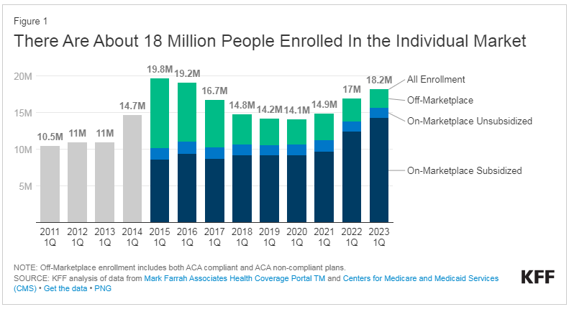
Exchange Growth

Slide 8
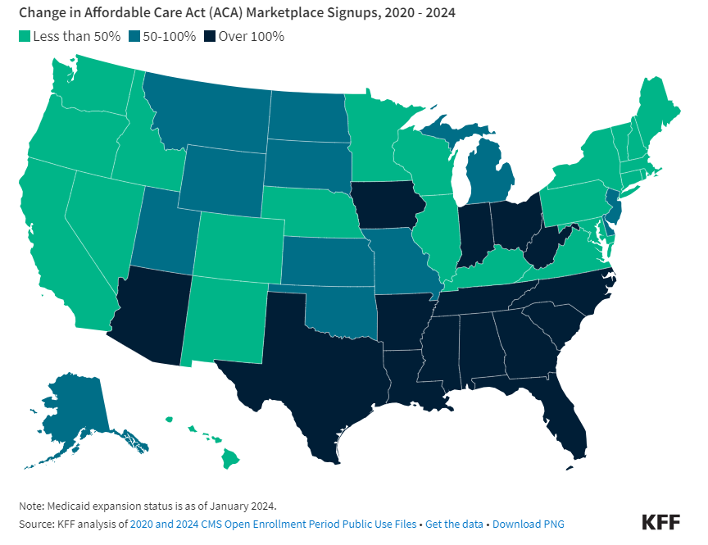
Exchange Growth
  The five states with the fastest growth in Marketplace enrollment since 2020: Texas (212%), Mississippi (190%), Georgia (181%), Tennessee (177%), and South Carolina (167%).
  All 5 states with high uninsured rates that have not expanded Medicaid.

Slide 9
Exchange Plan Growth/ICHRA
Georgia- Moves to State-Based Exchange
  DOI oversight of HIX plans for first time. Will it help with Ambetter garbage? Not sure….
Rural Georgia Impact
  Ambetter is now a top three overall payor for most practices in Georgia – big three are Anthem Commercial, UHC Medicare & Ambetter.
  Still dealing with plans like Cigna Connect and Blue Value with clearly inadequate networks.
How Stable is the Exchange Market?
  Future of Subsidies - Enhanced premium subsidies remain in place through 2025; Congress will need to act to keep them in place after that.
  Impact of ICHRA on Exchange Plan Enrollment and Commercial Plan Enrollment Decline?
Data still suggests that over 85% of HIX members were previously uninsured….but that may change with ICHRA…..

Slide 10
Individual Coverage Health Reimbursement Accounts
What is it/Who can offer an ICHRA?
  Allows businesses the alternative to offer employees a monthly allowance of tax-free $’s to buy individual health coverage.
  Can be offered by all employers with at least 1 W-2 employee.
  Covers employees eligible for health benefits in the company, plus dependents to the degree eligibility extended under employer health plan.
  Based on recent survey, 89% are considering ICHRA coverage over next 3 years.
Implications for a practice/ASC:
  Vast majority of Health Exchange members were previously uninsured, so accepting less than full commercial reimbursement was somewhat acceptable.
  ICHRA will move in previously covered members at a high rate. Are we about to reprice commercial business to “HIX market rates”?
  Given almost exclusively high deductible plan designs, cash % of allowable averages 78% for SHP client base.

Slide 11
Medicare Advantage- National Perspective
Fastest growing healthcare population
  Medicare provides health insurance coverage for 65 million beneficiaries
    By 2060, projections estimate that this number will increase to 93 million and will account for 23% of the total US population.
    In 2023, the Medicare population became evenly split between traditional Medicare and Medicare Advantage enrollment.
    By 2033, projected that 62% of eligible Medicare beneficiaries will be enrolled in a Medicare Advantage plan.
CBO estimates MA plans pay 3% LESS than traditional Medicare to providers.
Scarcity of rural providers and low patient volume in rural areas is less appealing for MA plans.
Network adequacy standard enforcement has been nearly non-existent, thus leading to ability for plans to bully providers.
Notes:
https://www.beckershospitalreview.com/payer-issues/medicare-advantage-growth-among-top-5-commercial-payers.html

Slide 12
Medicare Advantage National Trends
 | FY2023 MA Membership | Percentage Growth (FY 2010 vs FY 2023)
Aetna | 3.3M | 532%
Anthem | 4.3M | 264%
Humana | 5.5M | 316%
Cigna | 573k | 178%
United Healthcare | 8.9M | 415%
Kaiser Permanente | 1.8M | 199%
Centene | 1.2M | 188%
Notes:
https://www.kff.org/medicare/issue-brief/medicare-advantage-in-2023-enrollment-update-and-key-trends/

Slide 13
MA Competitive Implications
MA Explosive Growth Impact on Practices/ASCs has pros and cons:
  Pro- Implications of more competition
    BCBS doesn’t necessarily dominate MA market like commercial.
    Has given other carriers glimmer of hope to compete/not leave BCBS dominant markets.
  Con- Implications of more MA and more MA options
    On average, 20-25 higher days in AR for MA plans vs. Traditional Medicare.
    More administrative burden/clearly excessive medical record requests.
    Higher pre-auth and claim denial rates.
      MA plans deny nearly 8% of pre-auths, more than double commercial plans.
      MA plan initial claim reject rate is over 40%.
Notes:
- Biggest shift in payer market continues to be traditional Medicare to Medicare Advantage plans.
- From 2019 to 2021, traditional Medicare has decreased from around 25% of total patient population to around 21.5%.
- Biggest beneficiary of that growth in the market has been Humana.
- This trend is certain to continue; current projections anticipate that nationally, Medicare Advantage will account for over half of all Medicare enrollments by CY 2030.
https://www.kff.org/medicare/issue-brief/medicare-advantage-in-2021-enrollment-update-and-key-trends/
- Impact on Practices/ASCs has pros and cons:
- Pro- More competition equals an area that BCBS doesn’t necessarily dominate due to historical pricing advantages/encourages other carriers to stay committed to market.
- Con- More MA and more MA options equals more administrative burden, higher denial rate, and, on average, 20-25 higher days in AR for MA plans vs. Traditional Medicare.

Slide 14
MA Plan Burden- Impact on Member
Patient Liability
  5-7 years ago, Medicare Advantage patient liability was roughly half of traditional Medicare – today, it equals or exceeds traditional Medicare. See example below:
Example Provider
Patient Liability as % of Allowable
 | 2019 | 2024
Traditional Medicare | 20.0% | 20.0%
Medicare Advantage | 14.5% | 32.4%

Slide 15
Understanding MA Reimbursement Differentials
Recent trend to attempt to implement sub-Medicare pricing in some areas, mostly UHC. Started with MD rates, lab, rad, etc. now expanding to ASC/Facilities/other provider types.
If contracted/in network, MA plans have no obligation to match Medicare methodologies in terms of payment structure, CPT/APC weights, multiple procedure rules, etc.
Be careful to include language that nails down Medicare rate structure, underlying weights, and payment policies.
  Saying the payment methodology needs to match Medicare is not enough.
Policy Changes Correlating to Compensation Reductions- Changes to payer bundling, MPR, etc. leads to sub-Medicare reimbursement, even if contracted rates are at/above Medicare. UHC again main culprit.
  Must be able to track correct payment accurately.

Slide 16
Sample County MA Enrollment- 2024
Movement toward HMO forces providers in network.
5 years ago, less than 5% HMO/No out of net plans in Chatham County.

Slide 17
MA PPO vs. HMO Plan Designs
Benefit Plan Comparison
Plan Overview | Wellcare Patriot No Premium (HMO-POS) |  |  | Wellcare No Premium Focus (HMO)
Monthly Premium | $0 |  |  | $0
Health Plan Premium | $0 |  |  | $0
Drug Premium | N/A |  |  | $0
Standard Part B Premium | $170 |  |  | $170
Part B Premium Reduction | No |  |  | No
Health Deductible | $0 |  |  | $0
Drug Plan Deductible | N/A |  |  | $0
Maximum Cost Share | $3400 In and Out-of Network; $3,400 In-Network |  |  | $3,450
Benefits | Wellcare Patriot No Premium (HMO-POS) |  |  | Wellcare No Premium Focus (HMO)
 | In Network | Out of Network | Out of Network | In Network |  | Out of Network
Primary doctor visit | $0 copay | 20% coinsurance per visit | 20% coinsurance per visit | $0 copay |  | N/A
Specialist visit | $0 copay | 20% coinsurance per visit | 20% coinsurance per visit | $30 copay per visit |  | N/A
Diagnostic tests & procedures | $0-20 copay | 20% coinsurance per visit | 20% coinsurance per visit | $0-75 copay |  | N/A
Lab services | $0 copay | 20% coinsurance | 20% coinsurance | $0 copay |  | N/A
Diagnostic radiology services (like MRI) | $0-150 copay | 20% coinsurance | 20% coinsurance | $0-275 copay |  | N/A
Outpatient x-rays | $0 copay | 20% coinsurance | 20% coinsurance | $10 copay |  | N/A
Urgent care | $35 copay per visit (always covered) | $35 copay per visit (always covered) | $35 copay per visit (always covered) | $25 copay per visit (always covered) |  | N/A
Occupational therapy visit | $35 copay | 20% coinsurance | 20% coinsurance | $40 copay |  | N/A
Physical therapy & speech & language therapy visit | $35 copay | 20% coinsurance | 20% coinsurance | $40 copay |  | N/A
Durable medical equipment (like wheelchairs & oxygen) | 20% coinsurance per item | 20% coinsurance per item | 20% coinsurance per item | 20% coinsurance per item |  | N/A
Prosthetics (like braces, artificial limbs) | 20% coinsurance per item | 20% coinsurance per item | 20% coinsurance per item | 20% coinsurance per item |  | N/A

Slide 18
Summary of Medicare Advantage Trends
This stuff ain’t going away; it’s going to grow, both in plan membership and in number of different carriers/plans involved.
Inevitably, there will be carrier consolidation (ala commercial market) but a zillion players right now.
Regulatory support/Network adequacy enforcement has been lacking; we have to defend ourselves.
Value based $’s might even out the game for primary care but not for specialists/ASCs (well, any time soon….).
Potential Gamechanger in 2025 Proposed Rule released by CMS – CMS proposes capping broker commissions and standardizing amongst all Medicare Advantage plans….
  Will huge push towards MA remain?
  Could it level the playing field between carriers?

Slide 19
Medicare Advantage Federal Updates
CMS Final Rule Standardized Compensation Elimination of Administrative Fees Prohibition of Volume-Based Bonuses Focus on Beneficiary Needs Impact on Brokers and Agents: The rule aims to level the playing field for MA plans. Court Case: A Texas district court judge paused the enforcement of the rule in July 2024, citing concerns that CMS overstepped its authority and that the rule was "arbitrary and capricious". CMS Response: CMS has issued revised 2025 fair market value (FMV) compensation amounts to reflect the court's decision, with FMV limits that are $100 less than the previously announced FMV standards. | Improving Seniors’ Timely Access to Care Act Streamline prior authorization. Establish an electronic prior authorization standard to streamline approvals. Reduce the amount of time a health plan is allowed to consider a prior authorization request. Require MA plans to report on their use of prior authorization and the rate of approvals and denials. Encourage MA plans to adopt policies that adhere to evidence-based guidelines *Has not been re-introduced in this Congress as of yet. | Medicare Patient Access and Practice Stabilization Act of 2025 Increase support for physicians and other practitioners in adjusting to Medicare payment changes. Seeks to reverse the latest round of physician payment cuts. Long term physician payment reform Value Based Care *Re-introduced January 31, 2025.

Slide 20
Payer Transparency
Notes:
Market Forces are Changing Things

Slide 21
Payer Pricing Transparency
Could be a gamechanger for market knowledge.
Seemingly critical component of negotiation/market analysis/vetting new market payers.
Publicly available data from payer submitted datasets that avoids having to obtain anecdotal competitor pricing information.
ASC/Surgery Case Caveat:
Requires a bit of swag to determine whether payment add-ons like implant reimbursement exist.

Slide 22
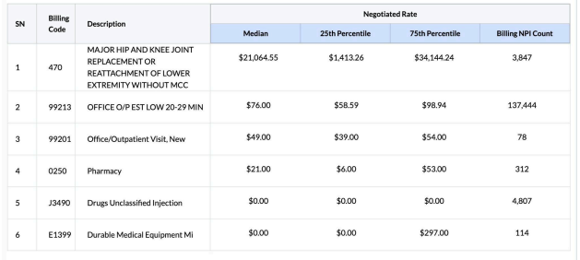
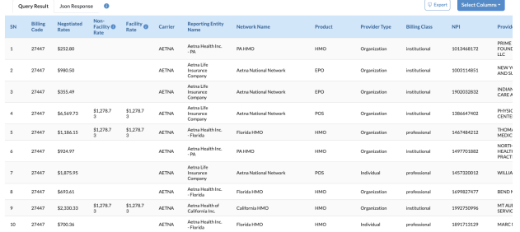
Payer/Pricing Transparency

Slide 23
Hospital vs. ASC Reimbursement

Slide 24
Hospital vs. ASC Reimbursement

Slide 25
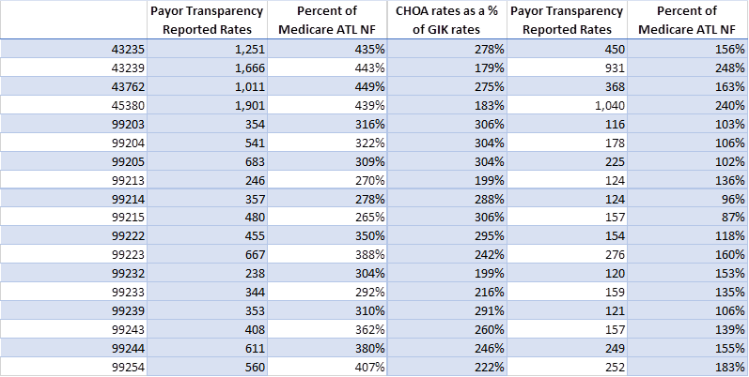
Payer/Pricing Transparency Case Study-
UHC/Atlanta Market Physician Rates

Slide 26
Surgical Practice Bundling Strategies
Notes:
Market Forces are Changing Things

Slide 27
ASC Bundles in the Commercial Market
2 Flavors:
  Carrier based bundled payment mechanisms
    Health plan overlay networks
    Centers of Excellence
  Direct to Employer/Direct Payer bundles
    Self-insured employers
    Cost-sharing patients (i.e. Medi-Share, Liberty, Christian Health Ministries).
While not uniformly pervasive across various markets currently, both seem to be growing.
Notes:
- 2 Flavors:
Carrier based bundled payment mechanisms that essentially represent an accounting of accumulated costs over a period of time to earn “shared savings” bonuses.
Direct to Employer/Centers of Excellence bundles designed to drive care to higher quality/lower cost providers based on lowering or eliminating patient liability for bundled care. Typically offered on top of usual benefit plan structure.
Neither are terribly pervasive at this point; however, both seem to be growing as more bundling administrators enter the market and carriers seek to drive care from hospitals to free standing centers.

Slide 28
Carrier Based Bundled Payment Programs
Carrier-based bundled payment mechanisms for ASCs involve a single, lump-sum payment for a group of services related to a specific condition or procedure, incentivizing providers to improve care coordination and reduce costs.
Incentives:
  This payment model encourages providers to work together to improve care quality, reduce unnecessary procedures, and lower overall costs.
Examples:
  Bundled payments can cover a range of services, including pre-operative care, surgery, post-operative care, and follow-up visits, all related to a specific condition or procedure.
ASC Perspective:
  For ASCs, bundled payments can streamline the billing process, reduce administrative burdens, and potentially lead to faster payments.
Notes:
- 2 Flavors:
Carrier based bundled payment mechanisms that essentially represent an accounting of accumulated costs over a period of time to earn “shared savings” bonuses.
Direct to Employer/Centers of Excellence bundles designed to drive care to higher quality/lower cost providers based on lowering or eliminating patient liability for bundled care. Typically offered on top of usual benefit plan structure.
Neither are terribly pervasive at this point; however, both seem to be growing as more bundling administrators enter the market and carriers seek to drive care from hospitals to free standing centers.

Slide 29
Carrier Based Bundled Payment Program -Benefits
Cost Savings:
  Bundled payments can lead to significant cost savings for patients and payers by encouraging efficient resource utilization and reducing unnecessary services.
Improved Care Coordination:
  The bundled payment model incentivizes providers to work collaboratively, leading to better care coordination and improved patient outcomes.
Transparency and Choice:
  Bundled payments can provide patients and employers with greater transparency and choice in healthcare costs, as they can see the total cost of a procedure or episode of care.
Increased Efficiency:
  ASCs can focus on providing high-quality care within a fixed budget, leading to greater efficiency and potentially improved outcomes.
Notes:
- 2 Flavors:
Carrier based bundled payment mechanisms that essentially represent an accounting of accumulated costs over a period of time to earn “shared savings” bonuses.
Direct to Employer/Centers of Excellence bundles designed to drive care to higher quality/lower cost providers based on lowering or eliminating patient liability for bundled care. Typically offered on top of usual benefit plan structure.
Neither are terribly pervasive at this point; however, both seem to be growing as more bundling administrators enter the market and carriers seek to drive care from hospitals to free standing centers.

Slide 30
D2E ASC Bundled Payment Programs
Direct-to-employer contracting for Ambulatory Surgical Centers (ASCs) involves ASCs negotiating bundled payment contracts directly with employers, bypassing traditional insurance companies, to offer cost-effective, high-quality care to employees.
Bundled Payments:
  A single payment covers all services related to a specific procedure, including pre-operative, operative, and post-operative care.
Focus on Value:
  This approach aims to align the interests of employers, ASCs, and employees by focusing on quality, cost, and patient outcomes.
Notes:
- 2 Flavors:
Carrier based bundled payment mechanisms that essentially represent an accounting of accumulated costs over a period of time to earn “shared savings” bonuses.
Direct to Employer/Centers of Excellence bundles designed to drive care to higher quality/lower cost providers based on lowering or eliminating patient liability for bundled care. Typically offered on top of usual benefit plan structure.
Neither are terribly pervasive at this point; however, both seem to be growing as more bundling administrators enter the market and carriers seek to drive care from hospitals to free standing centers.

Slide 31
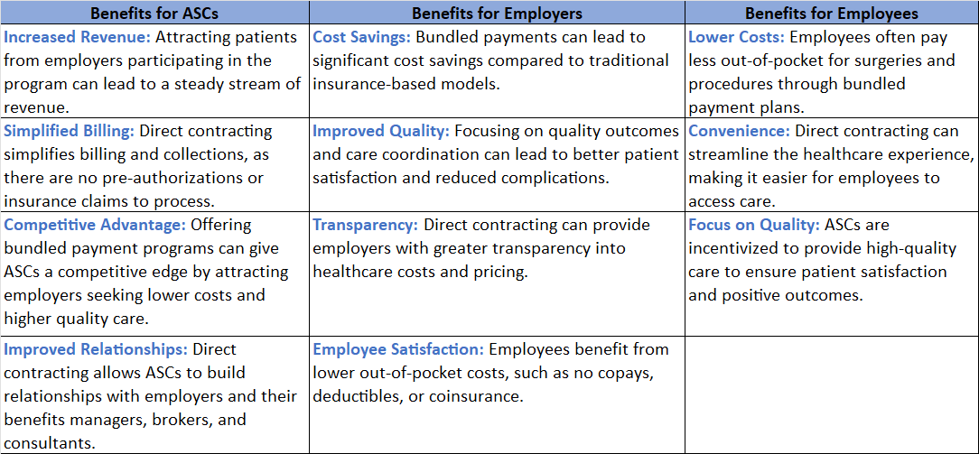
Benefits of D2E ASC Bundled Payment Programs
Notes:
- 2 Flavors:
Carrier based bundled payment mechanisms that essentially represent an accounting of accumulated costs over a period of time to earn “shared savings” bonuses.
Direct to Employer/Centers of Excellence bundles designed to drive care to higher quality/lower cost providers based on lowering or eliminating patient liability for bundled care. Typically offered on top of usual benefit plan structure.
Neither are terribly pervasive at this point; however, both seem to be growing as more bundling administrators enter the market and carriers seek to drive care from hospitals to free standing centers.

Slide 32
Typical D2E Bundling Mechanics
Right network of providers (surgeon, anesthesia, facility, etc.)
  Provider agreements, including impact of denials, etc.
Bundle development
  Definition of care period
  Included services
  Quality measures
Bundling administrator (HealthMe, Coral, etc.)
  Contracting
  Billing acceptance
  Payment process/mechanism
Distribution
  Sales mechanism to local employment base
  Ongoing customer service/solicitation
Notes:
- 2 Flavors:
Carrier based bundled payment mechanisms that essentially represent an accounting of accumulated costs over a period of time to earn “shared savings” bonuses.
Direct to Employer/Centers of Excellence bundles designed to drive care to higher quality/lower cost providers based on lowering or eliminating patient liability for bundled care. Typically offered on top of usual benefit plan structure.
Neither are terribly pervasive at this point; however, both seem to be growing as more bundling administrators enter the market and carriers seek to drive care from hospitals to free standing centers.

Slide 33
Key Takeaways
Potentially a growth strategy leveraging pricing advantages vs. Hospital oriented markets, however, not a good fit for all ASCs.
Bundled payments are complex to develop and monitor against full direct and indirect costs.
Successful plans are those that have closely aligned providers and payers who share data seamlessly (and many times are part of the same organization, which solves a multitude of issues).
A clearly defined bundle procedure, services included, timeframe of care, quality measures, attribution, administration, risk adjustment, gainsharing and data is crucial.
Bundled payment programs also present challenges in the development, attribution, accountability and distribution of the bundles.
Notes:
- 2 Flavors:
Carrier based bundled payment mechanisms that essentially represent an accounting of accumulated costs over a period of time to earn “shared savings” bonuses.
Direct to Employer/Centers of Excellence bundles designed to drive care to higher quality/lower cost providers based on lowering or eliminating patient liability for bundled care. Typically offered on top of usual benefit plan structure.
Neither are terribly pervasive at this point; however, both seem to be growing as more bundling administrators enter the market and carriers seek to drive care from hospitals to free standing centers.

Slide 34

Strategy Development in the “New, New World”
Market Analysis
Financial Analysis
Payer Transparency Analysis
Ease of Patient Access/ Payer Admin Burden
DTE Strategy

Slide 35

Some Closing Thoughts ......
Current noise asks for short term attention, but long-term strategy needed.
Federal situation is a double-edged sword. Some form of MA oversight vs. so much funding uncertainty with current cost cutting bent...
Integrating use of Payer Transparency for real renegotiation impact. Big difference between shoving real data in carriers face vs true wins, but it's worth a shot....
D2E Bundling Strategy- Lots of opportunity.....if approached carefully, in pricing, service, and sales.
?
$
?
! !
?
$
?
$
Notes:
Often antagonistic payor relationships.
Only conversation was ever about money or administrative pain to get paid.
Basically asking “Mother may I?” when time to fix issues/address rates.
- Managing patient burdens to continue providing care.

Slide 36
ASC Data Analytics...Coming to You in August!
Revenue cycle analytics best practices
Payer scorecarding
Underpayments
Payer transparency
Surgical case profitability analysis
Anesthesia Insource vs. Outsource/Effective Analytics
Notes:
https://www.beckershospitalreview.com/payer-issues/medicare-advantage-growth-among-top-5-commercial-payers.html

Slide 37
Contact Us
Mike Scribner 912-657-6304 mscribner@shpllc.com | Robyn Garrett 912-312-3205 rgarrett@shpllc.com

Slide 38

Wrap Up & Questions

Slide 39
Graphic Credits
https://www.istockphoto.com/photos/surgical-equipment
https://practolytics.com/blog/no-surprises-act-how-it-affects-you-as-a-practice/
https://www.commonwealthfund.org/publications/maps-and-interactives/2022/feb/map-no-surprises-act
https://umhca.org/NoSurprisesAct2022
https://en.m.wikipedia.org/wiki/File:Cog-scripted-svg-blue.svg
https://www.dreamstime.com/illustration/medical-cartoon.html
https://towardsdatascience.com/a-practical-guide-for-data-analysis-with-pandas-e24e467195a9
https://www.fullstack.com.au/expense-reimbursement/
https://www.vectorstock.com/royalty-free-vector/money-problem-financial-trouble-depressed-vector-28266243

