Slide 1
Managed Care Tactics & Strategy
Mike Scribner, Principal at Strategic Healthcare Partners
Kelly Mooney, VP of Managed Care at Strategic Healthcare Partners

Slide 2
Strategic Healthcare Partners, LLC –
Who We Are and Who We Serve
Founded by Principals John Crew and Mike Scribner in 2009.
Over 30 years experience in the field.
Broad spectrum of healthcare clients including:
  Rural/Urban/PPS/Critical Access Hospitals/ASCs
  Over 1,500 physicians/extenders
  IPAs, CINs, ACOs
Client services
  Revenue Cycle Support
  Managed Care Contracting
  Decision Support/Financial Analysis
Notes:
Strategic Healthcare Partners was founded by Principals John Crew and Mike Scribner in 2009.
SHP brings over 30 years experience fighting alongside rural/smaller healthcare providers to ensure ongoing viability and success.
SHP serves a broad spectrum of healthcare clients; including 35+ hospitals, over 1,000 physicians/extenders, IPAs/CINs, ASCs, and all 22 of the community mental health centers in Georgia.
- ASC Services include contract negotiation, managed care strategic planning, financial analysis, supply chain analysis, and revenue cycle analytics.

Slide 3

Traditional Specialty Practice/ASC Managed Care “Strategy”
Financial Analysis
Market Analysis
In-Network vs. Out-of-Network
Summary Strategy:
MD side- Be in everything/match your referral sources;
ASC side default to out of network, then evaluate as reimbursement goes south, no out of net benefit plans become prevalent, and pre-auth gets tougher to obtain on OON basis.

Slide 4

Where did this leave us?
?
$
?
! !
?
Often antagonistic payor relationships.
Only conversation was ever about money or administrative pain to get paid.
Basically asking “Mother may I?” when time to fix issues/address rates.
Managing patient burdens to continue providing care.
$
?
$
Notes:
Often antagonistic payor relationships.
Only conversation was ever about money or administrative pain to get paid.
Basically asking “Mother may I?” when time to fix issues/address rates.
- Managing patient burdens to continue providing care.

Slide 5

Strategy Development in the “New, New World”
Financial Analysis
Market Analysis
Payer Transparency Analysis
Ease of Patient Access/ Payer Admin Burden
DTE Strategy

Slide 6

Managed Care Landscape

Slide 7

What is the Current Playing Field?
Commercial Plan Growth, Consolidation
and the Big Four.
Impact of the ACA
  Medicaid Expansion
  Healthcare Exchange
Biggest shift, Medicare to Medicare Advantage plans.
Notes:
- Payer Mix has been relatively stable for the last five years but that is rapidly changing thanks to expansion & growth of governmental carriers.
- Commercial Plan growth really limited to the Big Five….Aetna, Anthem, Cigna, Humana & United.
- Major mergers appear to be off the table for now.
- Exchange plan growth has disrupted this established hierarchy.
- With the bolstered exchange plan subsidies, enrollment in the Exchange remains off the charts.
- From 2021 to 2022:
- Georgia enrollment jumped from 514,000 to 654,000.
- South Carolina enrollment jumped from 230,050 to 300,392.
- South Carolina’s Exchange market has been static since 2020; with BCBSSC, Molina, Bright and Ambetter in the market
- Georgia has seen greater market deployment for the Exchange; in 2022, five new payers entered the market.
- BUT, a free for all for Exchange volume has tied more carriers into a desire to compete in both GA and SC markets.

Slide 8
Commercial Consolidation Trend
Over the last ten years – the biggest health plan trend has been continued consolidation/market specialization.
  In 2022, UnitedHealth Group and Centene were the largest commercial and ACA marketplace private insurers, each with 14 % market share.
  In 2020, five for-profit insurers—Centene, Elevance, UnitedHealth Group, Molina, and CVS Health—together accounted for 50 percent of national Medicaid managed care enrollment.
  And in 2022, three payers—UnitedHealth Group, Humana, and CVS/Aetna—captured a significant share of the rapidly growing Medicare Advantage market, which serves millions of older Americans and now accounts for more than half of Medicare enrollment.
Acquisitions between health plans and providers have also established the health plan as competition to the independent providers in the market
  i.e. Humana acquisition of Centerwell, Cigna stake in Village MD, etc.
Overall impact of consolidations:
  Classic impact of a drift toward monopoly level market share in any industry.
  While initially sold as cost-containment exercises (consolidation of services, etc), Insurers have reaped most of the financial rewards from network consolidations while consumers face increased prices and diminished choices for care, and some providers wind up undercompensated (or at least stagnated rates during times of high inflation).

Slide 9
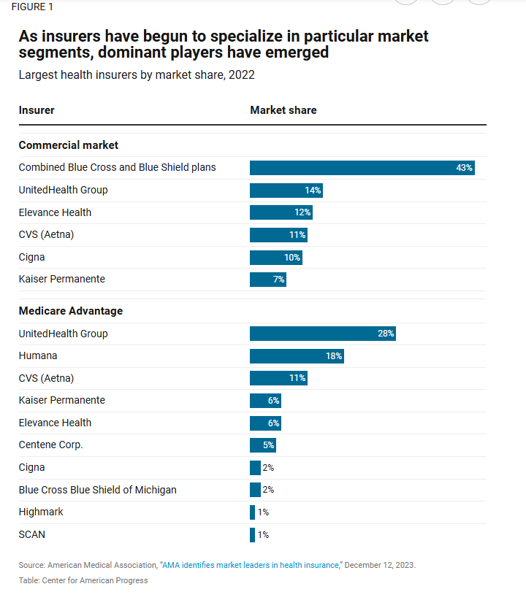
Commercial Market Share

Slide 10
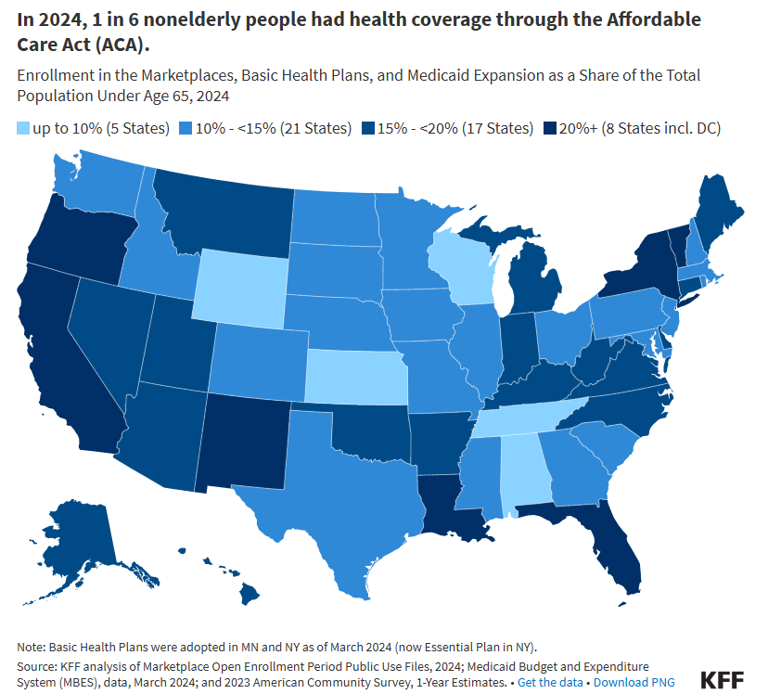
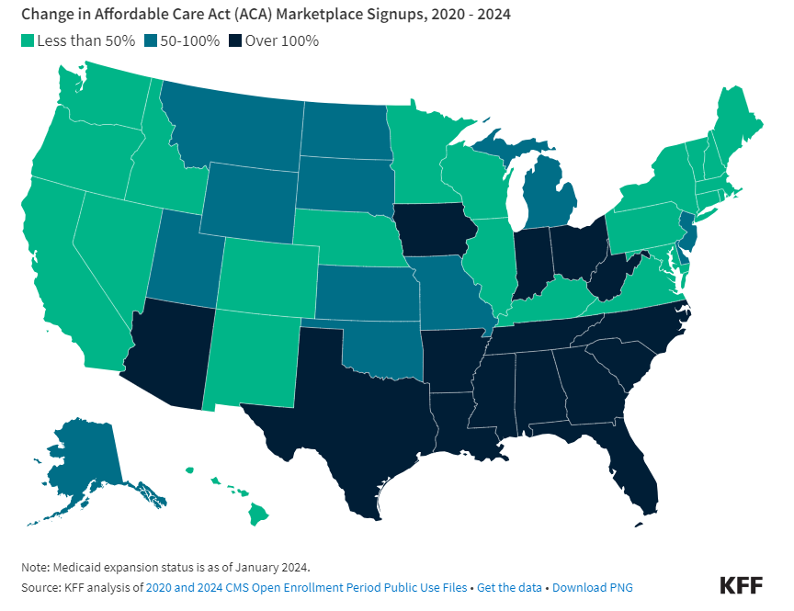
Impact of the ACA

Slide 11
Exchange Plan Growth
Individual Market Plans
  Record Setting Exchange Enrollment Continues
    In 2024, Exchange Plan Growth surpassed 20 million enrollees for the first time.
    30% growth between 2023 and 2024.
    Three states-Texas, Florida & Georgia –accounted for half of the Exchange plan growth during this time (3 non-Medicaid expanding states).
    Enhanced premium subsidies remain in place through 2025; Congress will need to act to keep them in place after that.
    Data still suggests that over 85% of HIX members were previously uninsured….but that may change with ICHRA…..maybe?

Slide 12
Exchange Growth
  The five states with the fastest growth in Marketplace enrollment since 2020 – Texas (212%), Mississippi (190%), Georgia (181%), Tennessee (177%), and South Carolina (167%) – all started off with high uninsured rates before the enhanced subsidies rolled out and they have not expanded Medicaid under the ACA.

Slide 13
Individual Coverage Health Reimbursement Accounts (ICHRA)
What is it/Who can offer an ICHRA?
  Allows businesses the alternative to offer employees a monthly allowance of tax-free $’s to buy individual health coverage.
  Can be offered by all employers with at least 1 W-2 employee.
  Covers employees eligible for health benefits in the company, plus dependents to the degree eligibility extended under employer health plan.
Implications for a practice:
  Still a tiny slice of overall employer based coverage – estimated 500,000 of approximately 165 million covered lives
  But interest is growing - based on recent survey, 89% are considering ICHRA coverage over next 3 years.
Actual increase from 2023 to 2024 was 29%.

Slide 14
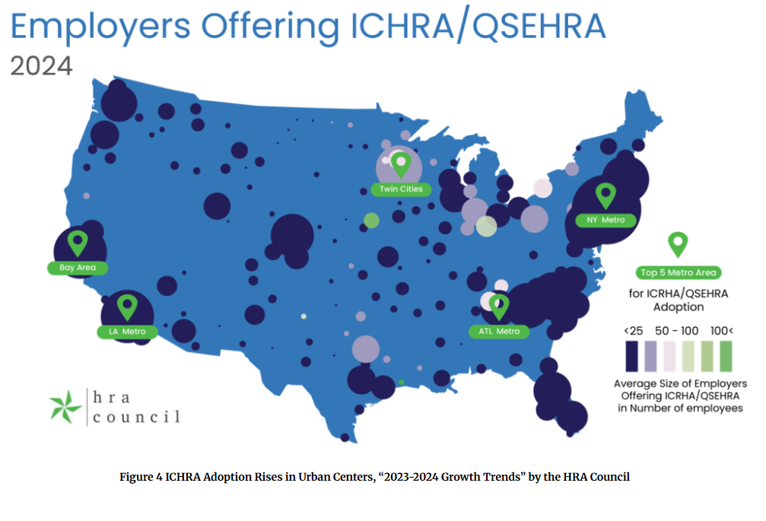
ICHRA Employer Types
ICHRA still have minimal saturation and much more common in smaller employers

Slide 15
How Will ICHRA Impact Providers?
How will it change the landscape?
  Vast majority of Health Exchange members were previously uninsured, so accepting less than full commercial reimbursement was somewhat acceptable.
  ICHRA could move in previously covered members at a high rate. Are we about to reprice commercial business to “HIX market rates”?
    Could be net positive for physician practices but more challenging for ASC facilities based on pricing differentials between Commercial & HIX.
    Should providers consider previously insured vs. uninsured rate structures in their HIX agreements?

Slide 16
Exchange Growth Implications
  In states dominated by Anthem (or any single commercial carrier), HIX growth has allowed for a new market to grow from standing start to increase competition in those states.
  Some states have seen steps toward a reversal of near monopolistic BCBS market share as HIX and MA markets didn’t inherit huge pricing advantage maintained by BCBS for commercial market.
  Created an additional tier of pricing for providers that slid in between Medicare and Commercial in most markets.
    In low priced markets (or lower priced services), generally beneficial pricing vs. current commercial agreements, however, in most markets created middle tier 30-50% over Medicare and 20-30% less than commercial.
    Some payers have attempt to use Medicaid managed care network as platform for HIX product without pricing adjustment. Most providers decline, however, network adequacy enforcement non-existent.

Slide 17
Exchange Growth Implications
  Created soft landing spot for Medicaid unwinding by inheriting the bulk of disenrollments vs. their transition into self pay.
    (into HIX plans that generally pay more than Medicaid/Medicaid managed care).
  Similar to MA, the myriad of new plans increases billing complexity.
  In many cases, contracts are not specific to individual or HIX market, therefore, providers open to have agreement apply to commercial products in future.
  In several markets, however, Centene has become (and acted like BCBS v 2.0) in the HIX space, so not all roses…

Slide 18
Medicare Advantage- National Perspective
Fastest growing healthcare population:
  Medicare provides health insurance coverage for 65 million beneficiaries.
    By 2060, projections estimate that this number will increase to 93 million and will account for 23% of the total US population.
    In 2023, the Medicare population became evenly split between traditional Medicare and Medicare Advantage enrollment.
    By 2033, projected that 62% of eligible Medicare beneficiaries will be enrolled in a Medicare Advantage plan.
CBO estimates MA plans pay 3% LESS than traditional Medicare to providers.
Scarcity of rural providers and low patient volume in rural areas is less appealing for MA plans.
Network adequacy standard enforcement has been nearly non-existent, thus leading to ability for plans to bully providers, thus, leading to larger health system pushback and plan terminations, typically UHC MA.
Notes:
https://www.beckershospitalreview.com/payer-issues/medicare-advantage-growth-among-top-5-commercial-payers.html

Slide 19
Medicare Advantage National Trends
 | FY2023 MA Membership | Percentage Growth (FY 2010 vs FY 2023)
Aetna | 3.3M | 532%
Anthem | 4.3M | 264%
Humana | 5.5M | 316%
Cigna | 573k | 178%
United Healthcare | 8.9M | 415%
Kaiser Permanente | 1.8M | 199%
Centene | 1.2M | 188%
Notes:
https://www.kff.org/medicare/issue-brief/medicare-advantage-in-2023-enrollment-update-and-key-trends/

Slide 20
MA Competitive Implications
MA Explosive Growth Impact on Practices/ASCs has pros and cons:
  Pro- Implications of more competition
    BCBS doesn’t necessarily dominate MA market like commercial.
    Has given other carriers glimmer of hope to compete/not leave BCBC dominant markets.
  Con- Implications of more MA and more MA options
    On average, 20-25 higher days in AR for MA plans vs. Traditional Medicare.
    More administrative burden/clearly excessive medical record requests.
    Higher pre-auth and claim denial rates.
      MA plans deny nearly 8% of pre-auths, more than double commercial plans.
      MA plan initial claim reject rate is over 40%.
Notes:
- Biggest shift in payer market continues to be traditional Medicare to Medicare Advantage plans.
- From 2019 to 2021, traditional Medicare has decreased from around 25% of total patient population to around 21.5%.
- Biggest beneficiary of that growth in the market has been Humana.
- This trend is certain to continue; current projections anticipate that nationally, Medicare Advantage will account for over half of all Medicare enrollments by CY 2030.
https://www.kff.org/medicare/issue-brief/medicare-advantage-in-2021-enrollment-update-and-key-trends/
- Impact on Practices/ASCs has pros and cons:
- Pro- More competition equals an area that BCBS doesn’t necessarily dominate due to historical pricing advantages/encourages other carriers to stay committed to market.
- Con- More MA and more MA options equals more administrative burden, higher denial rate, and, on average, 20-25 higher days in AR for MA plans vs. Traditional Medicare.

Slide 21
MA Plan Burden- Impact on Member
Patient Liability
  5-7 years ago, Medicare Advantage patient liability was roughly half of traditional Medicare – today, it equals or exceeds traditional Medicare. See example below:
Example Provider
Patient Liability as % of Allowable
 | 2019 | 2023
Traditional Medicare | 20.0% | 20.0%
Medicare Advantage | 14.5% | 32.4%

Slide 22
Where Do The Payers Want This To Go?
Recent trend to attempt to implement sub-Medicare pricing in some areas, mostly UHC. Currently, MD rates, lab, rad, etc. targeted for sub-Medicare vs. ASC/Facilities but likely coming for other provider types.
If contracted/in network, MA plans have no obligation to match Medicare methodologies in terms of payment structure, CPT/APC weights, multiple procedure rules, etc.
Be careful to include language that nails down Medicare rate structure, underlying weights, and payment policies.
  Saying the payment methodology needs to match Medicare is not enough.
Policy Changes Correlating to Compensation Reductions- Changes to payer bundling, MPR, etc. leads to sub-Medicare reimbursement, even if contracted rates are at/above Medicare. UHC again main culprit.
  Must be able to track correct payment accurately.
The more the pricing and adjudication methodologies move away from true Medicare, the less protection we have and the higher the need to accurately model rates and underlying adjudication rules.

Slide 23
Shift to HMO Plan Designs Limits Provider Options
Chatham County MA Enrollment 2019 vs. 2024.

Slide 24
MA PPO vs. HMO Plan Designs
Benefit Plan Comparison
Plan Overview | Wellcare Patriot No Premium (HMO-POS) |  |  | Wellcare No Premium Focus (HMO)
Monthly Premium | $0 |  |  | $0
Health Plan Premium | $0 |  |  | $0
Drug Premium | N/A |  |  | $0
Standard Part B Premium | $170 |  |  | $170
Part B Premium Reduction | No |  |  | No
Health Deductible | $0 |  |  | $0
Drug Plan Deductible | N/A |  |  | $0
Maximum Cost Share | $3400 In and Out-of Network; $3,400 In-Network |  |  | $3,450
Benefits | Wellcare Patriot No Premium (HMO-POS) |  |  | Wellcare No Premium Focus (HMO)
 | In Network | Out of Network | Out of Network | In Network |  | Out of Network
Primary doctor visit | $0 copay | 20% coinsurance per visit | 20% coinsurance per visit | $0 copay |  | N/A
Specialist visit | $0 copay | 20% coinsurance per visit | 20% coinsurance per visit | $30 copay per visit |  | N/A
Diagnostic tests & procedures | $0-20 copay | 20% coinsurance per visit | 20% coinsurance per visit | $0-75 copay |  | N/A
Lab services | $0 copay | 20% coinsurance | 20% coinsurance | $0 copay |  | N/A
Diagnostic radiology services (like MRI) | $0-150 copay | 20% coinsurance | 20% coinsurance | $0-275 copay |  | N/A
Outpatient x-rays | $0 copay | 20% coinsurance | 20% coinsurance | $10 copay |  | N/A
Urgent care | $35 copay per visit (always covered) | $35 copay per visit (always covered) | $35 copay per visit (always covered) | $25 copay per visit (always covered) |  | N/A
Occupational therapy visit | $35 copay | 20% coinsurance | 20% coinsurance | $40 copay |  | N/A
Physical therapy & speech & language therapy visit | $35 copay | 20% coinsurance | 20% coinsurance | $40 copay |  | N/A
Durable medical equipment (like wheelchairs & oxygen) | 20% coinsurance per item | 20% coinsurance per item | 20% coinsurance per item | 20% coinsurance per item |  | N/A
Prosthetics (like braces, artificial limbs) | 20% coinsurance per item | 20% coinsurance per item | 20% coinsurance per item | 20% coinsurance per item |  | N/A

Slide 25
Summary of Medicare Advantage Trends
MA growth not going away; it’s going to grow, both in plan membership and in number of different carriers/plans involved.
Inevitably, there will be carrier consolidation (ala commercial market) but a ton of players right now.
Absent significant provider pushback, the trend to sub-Medicare pricing will continue, starting with smaller independent practices not accessing a larger IPA/CIN mechanism.
Regulatory support has been garbage; we have to defend ourselves.
Value based $’s even out the game for primary care but not for specialists/ASCs
(well, not help any time soon….).

Slide 26
Payer Transparency
Notes:
Market Forces are Changing Things

Slide 27
Payer Pricing Transparency
Potential game changer for market knowledge.
Critical component of negotiation/market analysis/vetting new market payers in the new world.
Publicly available data now that avoids having to obtain anecdotal information/info providers aren’t supposed to have.
Data based on payer submissions/postings, therefore, would seem to be quite useful to leverage in payer discussions.

Slide 28
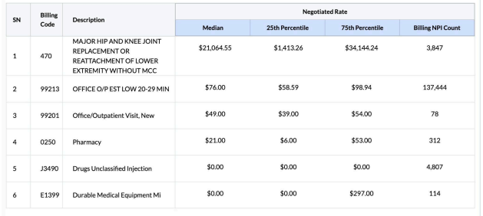
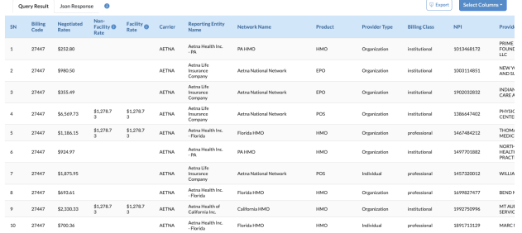
Payer/Pricing Transparency

Slide 29
Hospital vs. ASC Reimbursement

Slide 30
Hospital vs. ASC Reimbursement

Slide 31
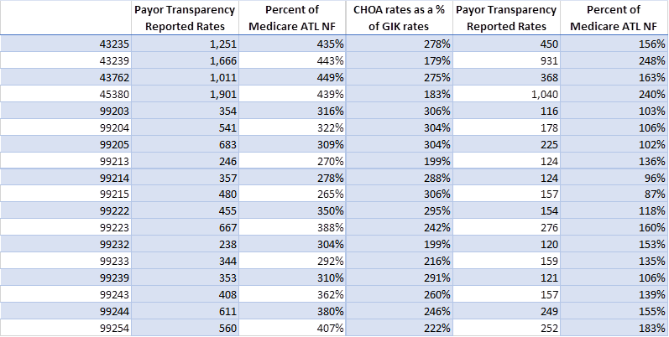
Payer/Pricing Transparency Case Study-
UHC/Atlanta Market

Slide 32
Payer Reaction to Transparency Data…So Far
Give it a solid C minus so far….
Range of reactions from gaslighting that their own data is wrong to those are outliers to comparison facilities aren’t appropriate.
Some acknowledgement of need for increase vs. legitimate comparison points in some circumstances.
Does reduce the need for IPA/CIN “black box” reviews as data could be publicly available already.
Potential change in tactic- Focus more on specific carveout type comparisons vs. overall to solicit better reaction.

Slide 33
Surgical Practice Bundling Strategies
Notes:
Market Forces are Changing Things

Slide 34
ASC Bundles in the Commercial Market
2 Flavors:
  Carrier based bundled payment mechanisms
    Health plan overlay networks
    Centers of Excellence
  Direct to Employer/Direct Payer bundles
    Self-insured employers
    Cost-sharing patients (i.e. Medi-Share, Liberty, Christian Health Ministries).
Huge variation in market penetration currently, but both seem to be growing.
Notes:
- 2 Flavors:
Carrier based bundled payment mechanisms that essentially represent an accounting of accumulated costs over a period of time to earn “shared savings” bonuses.
Direct to Employer/Centers of Excellence bundles designed to drive care to higher quality/lower cost providers based on lowering or eliminating patient liability for bundled care. Typically offered on top of usual benefit plan structure.
Neither are terribly pervasive at this point; however, both seem to be growing as more bundling administrators enter the market and carriers seek to drive care from hospitals to free standing centers.

Slide 35
Carrier Based Bundled Payment Programs
Carrier-based bundled payment mechanisms for ASCs involve a single, lump-sum payment for a group of services related to a specific condition or procedure, incentivizing providers to improve care coordination and reduce costs.
Incentives:
  This payment model encourages providers to work together to improve care quality, reduce unnecessary procedures, and lower overall costs.
  Some redirection of care in addition to financial incentives for achieving benchmarks.
Examples:
  Bundled payments can cover a range of services, including pre-op care, surgery, post-op care, and follow-up visits, all related to a specific condition or procedure.
ASC Perspective:
  For ASCs, bundled payments can streamline the billing process, reduce administrative burdens, and potentially lead to faster payments. But some potential downside risk.
Notes:
- 2 Flavors:
Carrier based bundled payment mechanisms that essentially represent an accounting of accumulated costs over a period of time to earn “shared savings” bonuses.
Direct to Employer/Centers of Excellence bundles designed to drive care to higher quality/lower cost providers based on lowering or eliminating patient liability for bundled care. Typically offered on top of usual benefit plan structure.
Neither are terribly pervasive at this point; however, both seem to be growing as more bundling administrators enter the market and carriers seek to drive care from hospitals to free standing centers.

Slide 36
D2E ASC Bundled Payment Programs
Direct-to-employer contracting for Ambulatory Surgical Centers (ASCs) involves ASCs negotiating bundled payment contracts directly with employers, bypassing traditional insurance companies, to offer cost-effective, high-quality care to employees.
Bundled Payments:
  A single payment covers all services related to a specific procedure, including pre-operative, operative, and post-operative care.
Focus on Value:
  This approach aims to align the interests of employers, ASCs, and employees by focusing on quality, cost, and patient outcomes.
  Ultimately, our experience is that DTE bundling is still a volume for lower pricing (or at least pricing predictability) fee for service play.
Notes:
- 2 Flavors:
Carrier based bundled payment mechanisms that essentially represent an accounting of accumulated costs over a period of time to earn “shared savings” bonuses.
Direct to Employer/Centers of Excellence bundles designed to drive care to higher quality/lower cost providers based on lowering or eliminating patient liability for bundled care. Typically offered on top of usual benefit plan structure.
Neither are terribly pervasive at this point; however, both seem to be growing as more bundling administrators enter the market and carriers seek to drive care from hospitals to free standing centers.

Slide 37
Key Takeaways
Potentially a growth strategy leveraging pricing advantages vs. Hospital oriented markets, however, not a good fit for all ASCs.
Bundled payments are complex to develop and monitor against full direct and indirect costs.
Successful plans are those that have closely aligned providers and payers who share data seamlessly (and many times are part of the same organization, which solves a multitude of issues).
A clearly defined bundle procedure, services included, timeframe of care, quality measures, attribution, administration, risk adjustment, gainsharing and data is crucial.
Bundled payment programs also present challenges in the development, attribution, accountability and distribution of the bundles.
Notes:
- 2 Flavors:
Carrier based bundled payment mechanisms that essentially represent an accounting of accumulated costs over a period of time to earn “shared savings” bonuses.
Direct to Employer/Centers of Excellence bundles designed to drive care to higher quality/lower cost providers based on lowering or eliminating patient liability for bundled care. Typically offered on top of usual benefit plan structure.
Neither are terribly pervasive at this point; however, both seem to be growing as more bundling administrators enter the market and carriers seek to drive care from hospitals to free standing centers.

Slide 38
So What?
Notes:
Market Forces are Changing Things

Slide 39
Strategy Development in the “New, New World”
Financial Analysis
Market Analysis
Payer Transparency Analysis
Ease of Patient Access/ Payer Admin Burden
DTE Strategy

Slide 40
Monitoring Payer Performance
Clean Claim Pass Rate by Payer
Denial Rates / Zero Pay by Payer by Code
Days in AR by Payer
Rates vs. Market
Underpayment by Payer
Assessing Administrative Burden by Payer
  MA Plans vs Traditional Medicare
  Pre-auth Burden
  Appeal Overturn Rate
Notes:
https://www.beckershospitalreview.com/payer-issues/medicare-advantage-growth-among-top-5-commercial-payers.html

Slide 41
Understand Payer Goals
Understanding carrier goals around other product lines and your issues with those products plays in to practice/ASC response.
Real Examples:
  ASC with exceptional % of charge Anthem commercial agreement (35% of payer mix vs. 2% Anthem MA product. Little motivation to fight MA issues.
  Practice/ASC with many Humana/UHC MA issues receives Medicaid managed care proposal. Response- No consideration of Medicaid until MA record requests/claim issues are resolved.

Slide 42
Annual Managed Care Strategy
Develop your annual plan:
  Consider all major plans/all major product lines.
  Special consideration and vetting for new carriers and new product lines of existing carriers.
  Understand shifts in payer market share by product line.
  Specifically lay out current rates vs. market via payer transparency.
Some considerations:
  Remember- Old agreement does not equal bad agreement; but old fixed rates (even with a small escalator) usually means below market rates.
  Know who is trying to put something new in the market. Determine whether they need you and impact on any leverage you might have.
  Managed care strategy needs to jive with overall growth/physician recruitment/local employer outreach strategy. Consider all when laying out strategy.
  Think long term vs. short term…if cash flow allows.

Slide 44

Wrap Up & Questions

Slide 45
Graphic Credits
https://www.istockphoto.com/photos/surgical-equipment
https://practolytics.com/blog/no-surprises-act-how-it-affects-you-as-a-practice/
https://www.commonwealthfund.org/publications/maps-and-interactives/2022/feb/map-no-surprises-act
https://umhca.org/NoSurprisesAct2022
https://en.m.wikipedia.org/wiki/File:Cog-scripted-svg-blue.svg
https://www.dreamstime.com/illustration/medical-cartoon.html
https://towardsdatascience.com/a-practical-guide-for-data-analysis-with-pandas-e24e467195a9
https://www.fullstack.com.au/expense-reimbursement/
https://www.vectorstock.com/royalty-free-vector/money-problem-financial-trouble-depressed-vector-28266243

