Slide 1
Turning Data Into Information
Mike Scribner, Principal @ Strategic Healthcare Partners
Janey Marsan, VP - Data Analytics

Slide 2
Strategic Healthcare Partners, LLC – Who We Still Are and Who We Still Serve
Founded by Principals John Crew and Mike Scribner in 2009.
Over 30 years experience in the field.
Broad spectrum of healthcare clients including:
  35+ hospitals
  Over 1,500 physicians/extenders
  20+ ASCs
ASC services
  Managed Care Strategy and Contracting
  Revenue Cycle Analytics and Support
  Pro Forma Development/Feasibility Analysis
  Facility Credentialing/Payer Enrollment

Slide 3
What We Typically See…..
ASCs, particularly independent surgeon owned ASCs, run administratively lean without a CFO or in-house analyst support.
Practice/ASC systems produce more data than ever but how is that translating into interpretation and action?
  Cash based accounting for financial statements are helpful but incomplete cash collections are a lagging indicator of literally anything affecting revenue in the business:
    Volume slowdown
    Cash flow interruption
    Adverse payer mix
    Increased denials, etc.
  Ad hoc data analysis vs. established rhythm of replicable reporting with digestible benchmarks and targets that can be easily digested.
Data points without a trend, target, or benchmark are unhelpful. Critical to have trend direction and target/benchmark comparison to provide relevancy to all data.

Slide 4
Driving Information Into Action
What do we know??? What are we guessing at????
  Volume of denials? By code? By payer? high-cost the net revenue lost vs. charges?
  Days in AR…by payer? Which are outliers to address specifically?
  Are we being paid correctly by at least the top payers?
  Top referral sources volume trend over past year? Payer mix trend?
  Profitability of high-cost implant surgeries? By payer?
  Projected volume and net revenue for next couple of years?
  Patient liability collections by payer vs. total collectible patient liability?
The question isn’t what reporting can the system do. The question is what do I need to know, and when do I need to know it?

Slide 5
So What Do I Need to Know…. And When?
Report frequency and replicability
Key Tracks:
  Revenue Cycle
  Volume/Growth
  Profitability
  Managed Care
Prioritizing high return activities by quantifying results.

Slide 6
What Do I Need to Know…. And When? (Con’t…)

Slide 7
Flash Reporting Example
Sample flash report tracking cash flow, charge posting, AP, AR, and general volume.
Looking for quick info on slow cash, AR drift, volume drops, etc.
Do this 3 months in a row, and you’ll accurately predict financial bottom line before the accountant sends them….

Slide 8
Rolling Cash Projection
Intended to be daily/weekly updated projection of cash flow to anticipate issues/one off paybacks, etc.
Not as big a pain to do each day/week as you’d think….

Slide 9

Revenue Cycle
Notes:
Market Forces are Changing Things

Slide 10
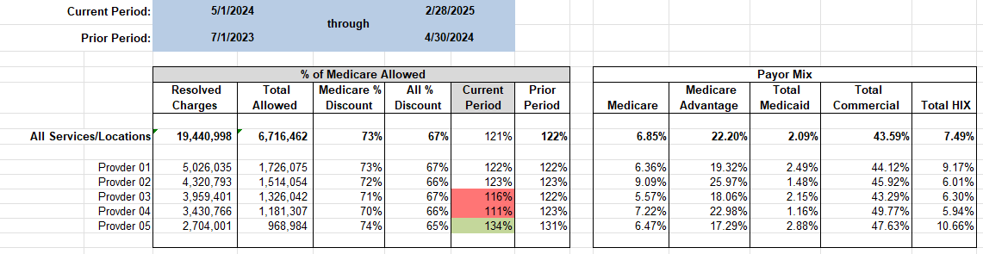
Volume Snapshot
Comparing % of Medicare for current vs. baseline period by surgeon.
Arraying with payer mix (and overall change of payer mix to explain YOY differences.
Also, seeking to understand provider vs. provider reimbursement differences (as shown above).
Almost all revenue cycle trending needs to be date of service based based to be meaningful. Transaction based not generally helpful.

Slide 11
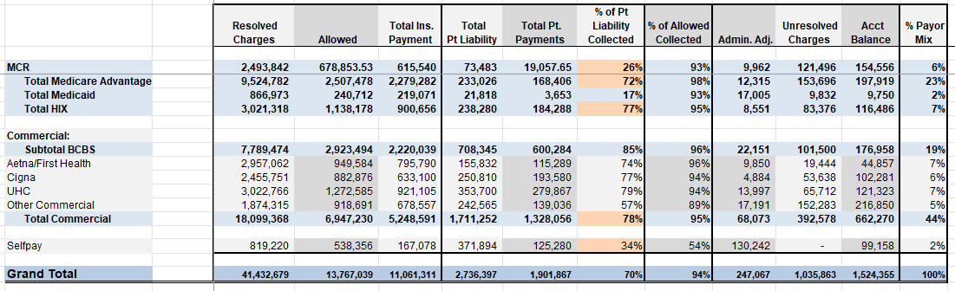
Overall Analysis of Resolved Claims by
Financial Class/Payer
Snapshot of reimbursement/collections (both insurance and patient) by payer.
Serves as a bit of a reference to understand charge based payer mix vs. collections based.

Slide 12
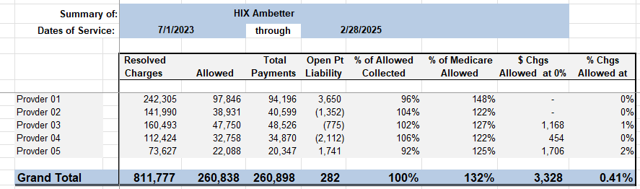
Payer Snapshot
Snapshot of relative reimbursement, % of allowable collected, and zero paid claims by payer.
Serves as quasi-underpayment analysis for % of Medicare based agreements. Typically, MA and ACA products.
Why is provider 1 getting paid so much better than the others? What is relative zero pay % by payer?

Slide 13
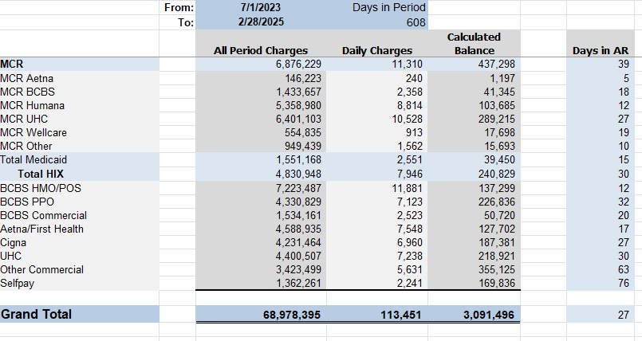

Monitor Days in AR by Payer
Typically, overall days in AR is known number, but not by payer.
Seeking to identify outliers that slow pay in general or excessive medical requests, etc. drive up relative days in AR. For example, UHC and Other Commercial tend to be terrible……
Notes:
Change AR selections

Slide 14
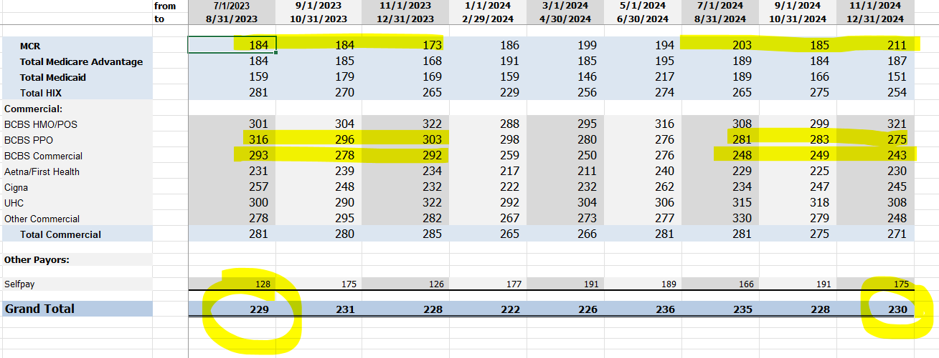
Monitoring Collections/Encounter/Payer Trended
Looking for payer level increases or drops in cash/case/payer over time. Either to validate negotiation/escalation increase or payer games.
Must be date of service based to be meaningful. Transaction based not generally helpful.

Slide 15
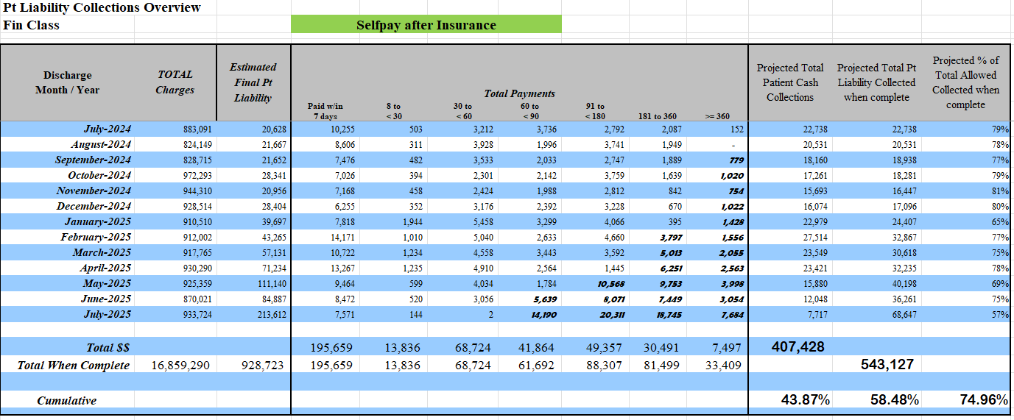

Patient Liability Collections Analysis
Arraying patient collections as a % of true patient liability (i.e. after secondaries) based on time vs. date of service. Essentially monitors upfront vs. early out/inhouse statements vs. collection agency.
Many ASCs at 80-90% or better. Live example above is at 44% due to poor POS collections.

Slide 16
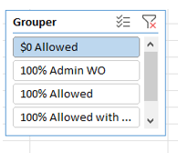
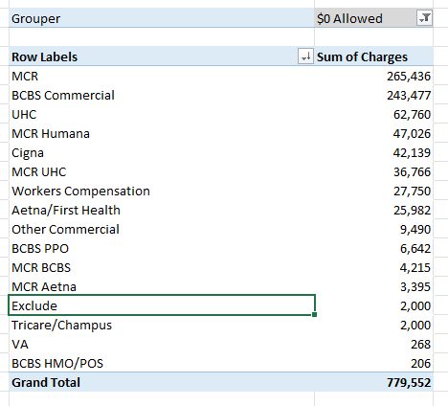
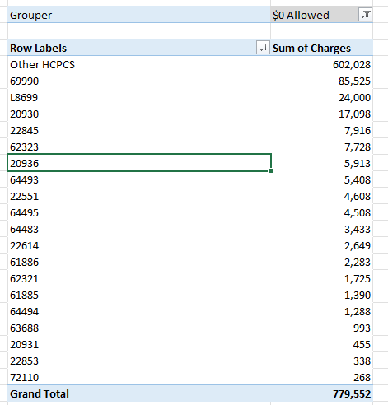
Denials by Payer by Code
Zero paid/fully written off claims by payer by code.
Goal to shine light on written off codes/claims that might be worth pursuit or post-mortem analysis of root cause.

Slide 17
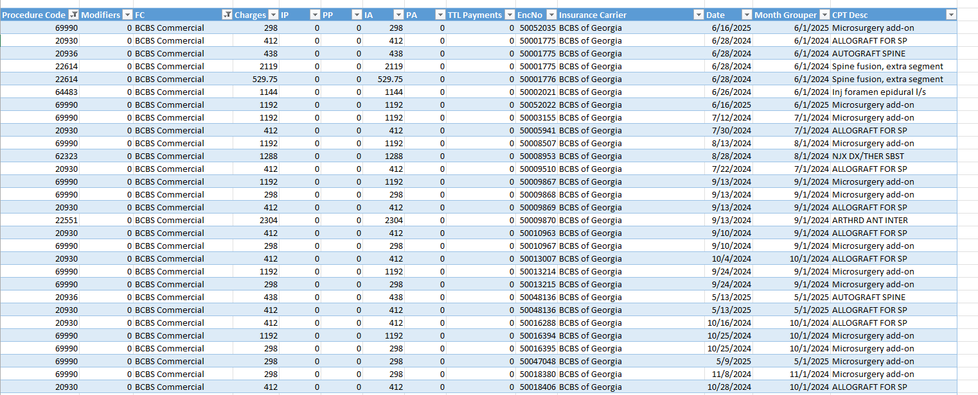
Details to research points of failure
- Claim level zero pay detail designed to provide audit material for ASC to review for revenue cycle issues or additional collection efforts. Shouldn’t be new information but frequently is.

Slide 18
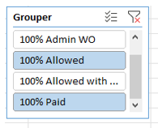
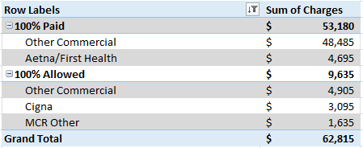
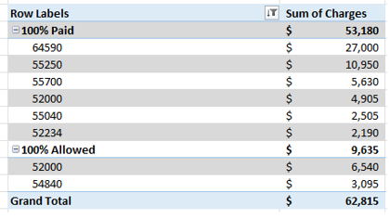
100% Paid by Payer by Code
Typically, reviewing for fully paid claims indicating potential for fee schedule higher than charges and a need to adjust chargemaster.
Not always a smoking gun but generally worth a periodic review vs. anecdotal adjustments from posters catching a 100% pay.

Slide 19
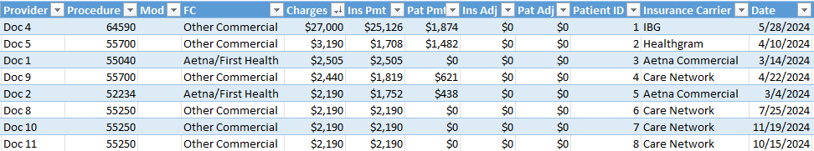
Details to Target Pricing Increase
Detail of 100% paid claims to trigger review.
End result is typically a chargemaster adjustment to avoid leaving lesser of charge or fee schedule $’s on the table.
Review contract terms, possible overpayment recoupment risk.

Slide 20
Volume/Growth
Notes:
Market Forces are Changing Things

Slide 21
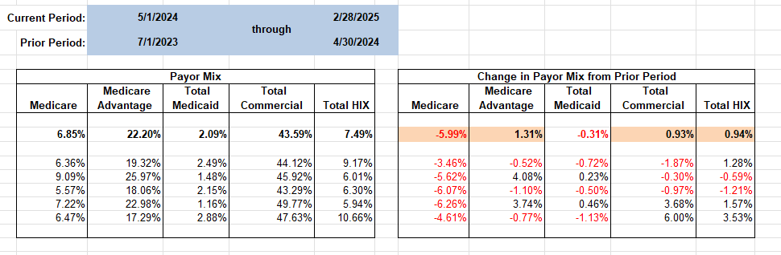
Payer Mix Trend Aggregated
Goal to examine payer mix trends/explain change in value of overall block of volume for comparison timeframes.
Strongly suggest splitting out HIX from commercial as the pricing is typically between Medicare and Commercial.

Slide 22
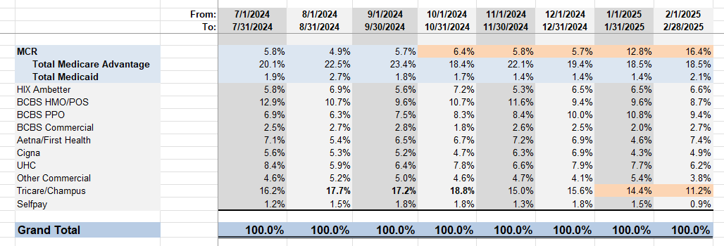
Payer Mix Trend Detailed
Trend of payer mix by financial class over time.
Goal to pick up early warning of payer mix trends. Example above shows drop in Tri-Care shifting toward Commercial. Basically positive, however, triggered review of Tri-Care volume reductions offsetting impact of mix improvement.
Notes:
Insert with collections / allowables by payor

Slide 23
Remember this . . .
Difference between governmental payers and commercial can be extreme. In this ASCs case, it takes 2 Medicaid cases to replace a lost commercial case.
Again, trends looking for payer pricing games, denials, etc to justify reductions such as BCBS above.

Slide 24
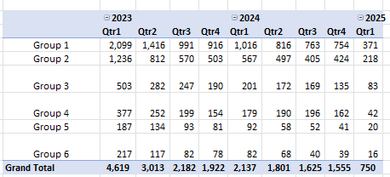
Practice Referral Source Trending
Trend of new patient referrals to practice by referring practice over time.
Not an ASC report, but, ASC volume drops only come from 1 of 3 or 4 areas: Loss of flow to the practice, payer direction to the hospitals, internal surgeon discontent pushing ASC volume to hospital, or patient safety concerns. Flow to practice generally #1 culprit.

Slide 25
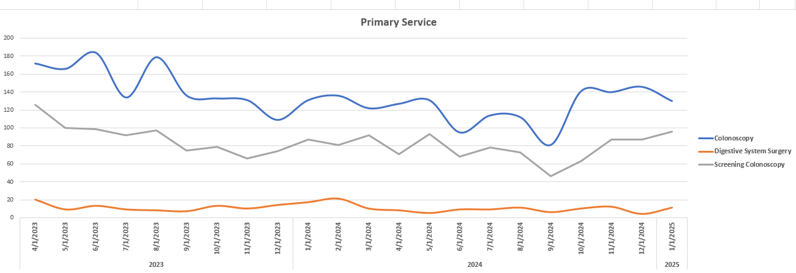
Referral Source
Remember the storm?
ASC volume resulting from specific practice referrals by service.
To track overall surgical volume flow by service line over time.

Slide 26
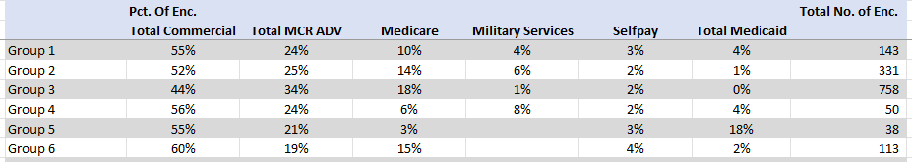
Referral Sources Payor Mix
Looking for referral sources with poor payer mix. Typically, heavy Medicaid or Tri-Care.
When building growth plans, need to understand potential volume flow but also the underlying payer mix shift that can come (positive or negative) from soliciting improved referral volume from specific sources.
We use it for growth planning, new service / new surgeon / new ASC feasibility studies.
Use for onboarding / exit planning of practitioners.

Slide 27
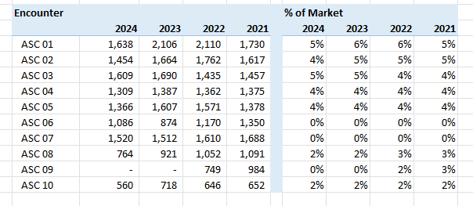
Market Share Analysis
https://dch.georgia.gov/health-planning-databases
Volume of cases in particular specialty for specific geography by year.
Used to analyze trends of market share/market outmigration over time.
We use it for growth planning, new service/new surgeon/new ASC feasibility studies.

Slide 28
Profitability
Notes:
Market Forces are Changing Things

Slide 29
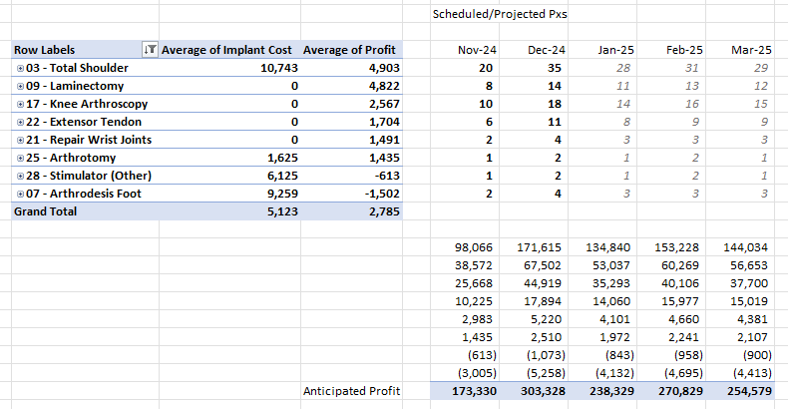
Surgical Case Profitability
Contribution margin (Net collections minus supply/implant cost) by code/service grouping by payer snapshot.
Goal to identify unprofitable services due to dropping reimbursement or increasing costs.
Purpose to assist with future profitability projections/budgeting as well as payer leverage.

Slide 30
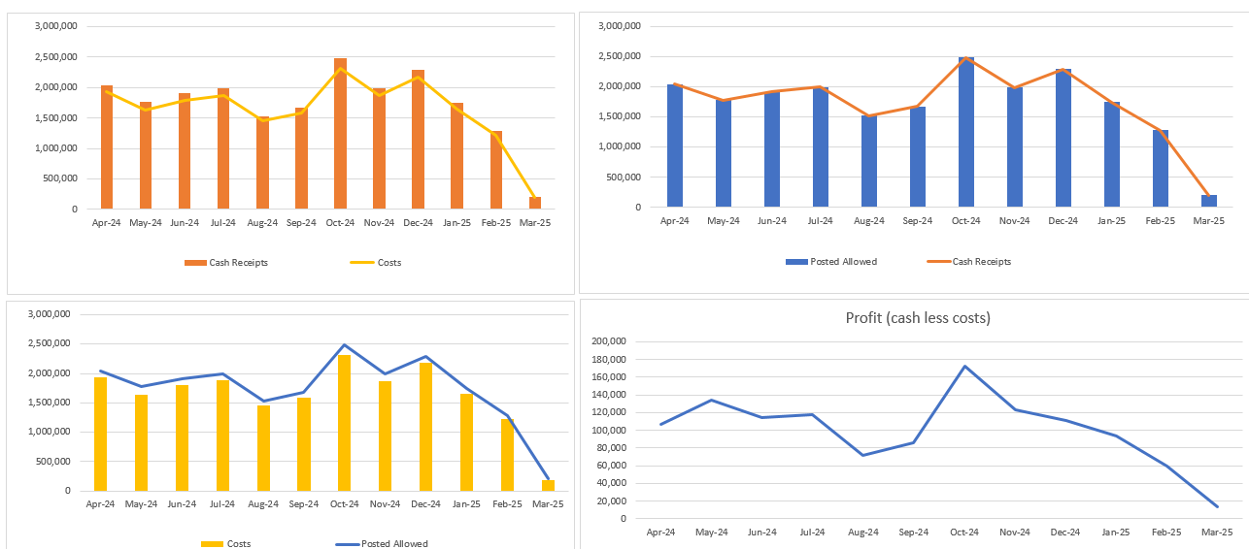
Implant/Drug Profitability
Overall implant/drug profitability over time overall and by implant/drug.
Example above showed impact of drugs being moved into Medicare pricing mechanism/out of “other” greatly reducing reimbursement, prompting need to adjust used drugs/implants or initiate payer outreach.

Slide 31
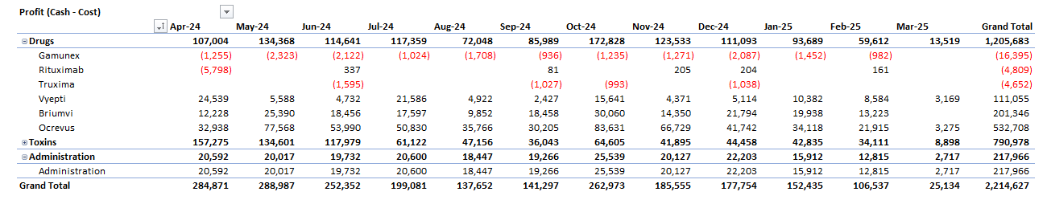
Implant/Drug Profitability
Chart of drug profitability trended over time by drug. Separately displayed by payer by drug.
Goal to identify unprofitable drugs or reduced profitability over time.

Slide 32
Managed Care Considerations / Payor Transparency
Notes:
Market Forces are Changing Things

Slide 33
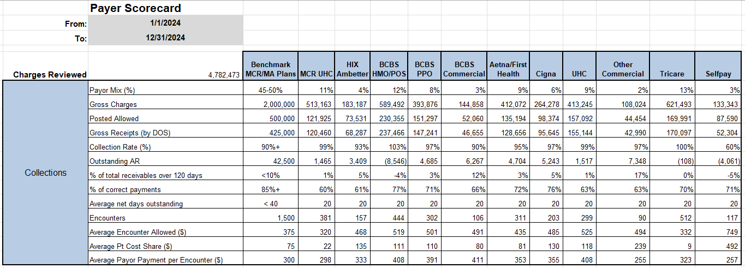
Payer Scorecard
Periodic scorecard to compare key metrix by payer (collection rate, AR over 120, % correct payments, payer days in AR, collections per encounter in one spot.
Reviewing for payer level differences to address with carrier or within internal processes if that somehow makes a difference.

Slide 34
Hospital vs. ASC Reimbursement
based on publicly available transparency data
Presented at last conference. Blast from the past to depress everyone….
Information available code by code/payer by payer/TIN by TIN.

Slide 35
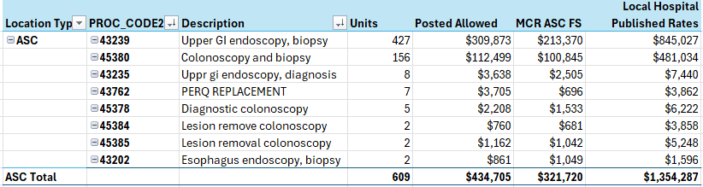
Specific ASC Transparency Using Hospital MRF
Specific example from recent negotiation for payer rejecting proposal due to (a) market rates and (b) unacceptable client cost increases.
Goal to demonstrate to payer increased cost of ASC shifted cases and relative Medicare %’s between ASC and local hospital.

Slide 36
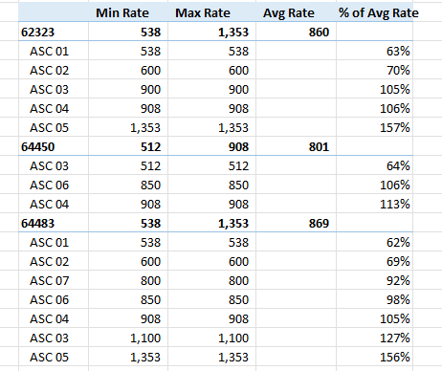
Specific ASC Transparency Using Payor MRF
ASC vs. ASC analysis. Same specialty/same market.
Highest facility is 264% higher reimbursed than lowest in market for same code.
Not unexpected as payer opening offers/ unnegotiated agreements have dropped drastically over past several years.

Slide 37
Contract Modeling Issues
Modeling current reimbursement vs. current agreement as baseline. Sounds easy, but……
Proposal methodology changes- COPPS vs. Groupers vs. Medicare, etc.
Implant add on- Yes/No, Methodology
Embedded bundling issues
Differing multiple procedure rules (MPR) by payer
Moving from one methodology to another….

Slide 38
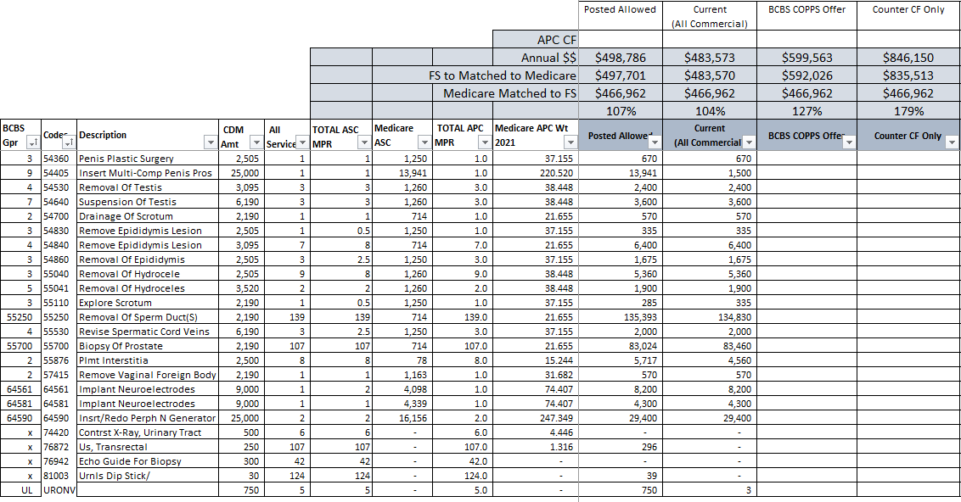
Contract Modeling Grouper to COPPS
Contract methodology being pushed by Anthem. Similar to Medicare APC reimbursement with some nuances.
Comes with push to eliminate implant reimbursement typically.

Slide 39
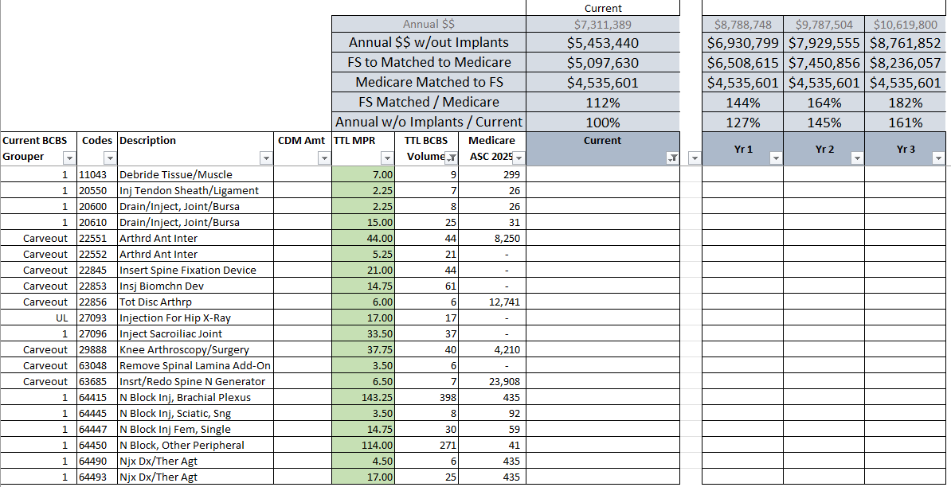
Contract Modeling Examples- Groupers Plus Carveouts
Modeling strictly from rate sheet is insufficient. Other payment rules can be significant.
Must understand payer grouping rules as Medicare no longer standard.
Allow understand implant method, MPR rule, codes with no additional reimbursement, etc.

Slide 40

Wrap Up & Questions

Slide 41
Follow Up: contact@shpllc.com

